Slide 1
Nixon and the Rise of Conservatives

Slide 2
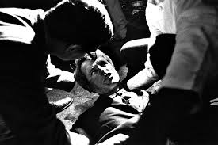
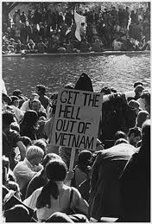
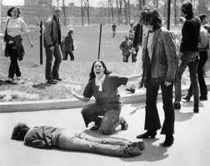
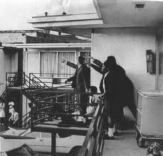
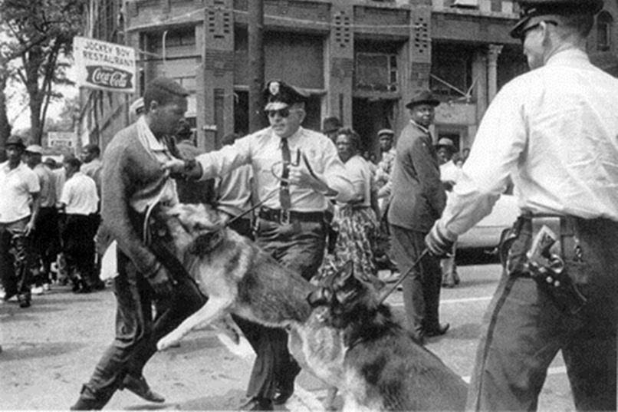
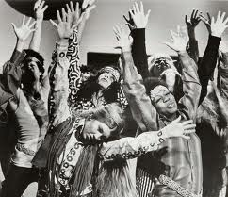
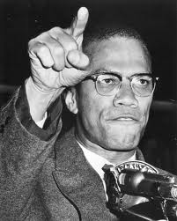
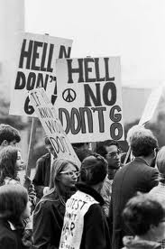
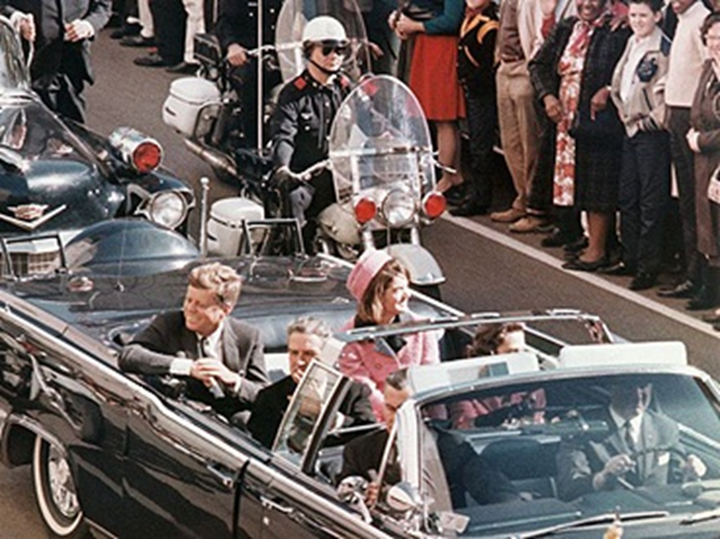
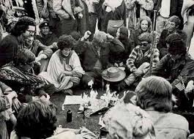
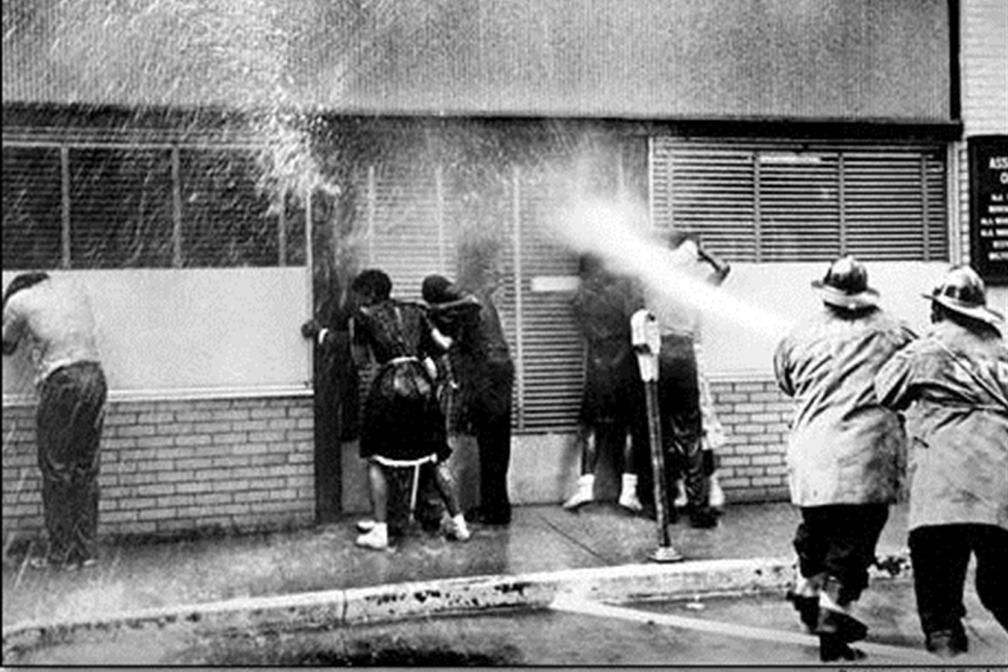
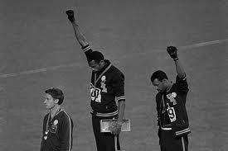
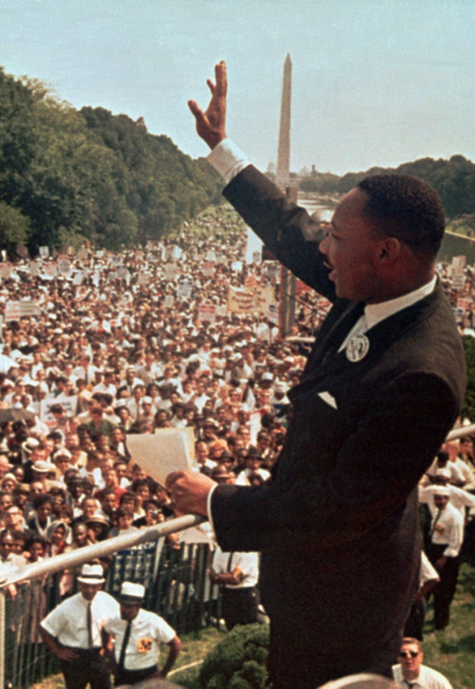
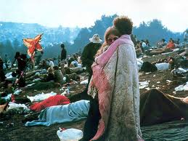
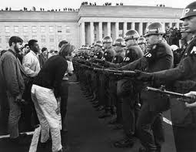
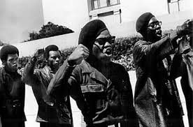
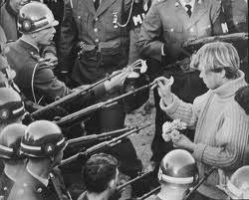
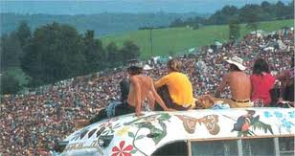
1960s Turmoil
Hippies/ Counterculture
Civil Rights Protests & Racial Violence
Black Power
Anti-Vietnam War Protest (Flower power)
Assassinations

Slide 3
The Presidency of Richard Nixon
By the late 1960s, citizens had seen enough turmoil in U.S. foreign & domestic affairs:
The economic boom of the 1950s & 1960s was starting to come to an end
American prestige in the world was damaged by the failure in Vietnam
Anti-war protests, “hippie” culture, & liberal gov’t programs led many citizens to believe that America was headed for moral decay & economic collapse

Slide 4
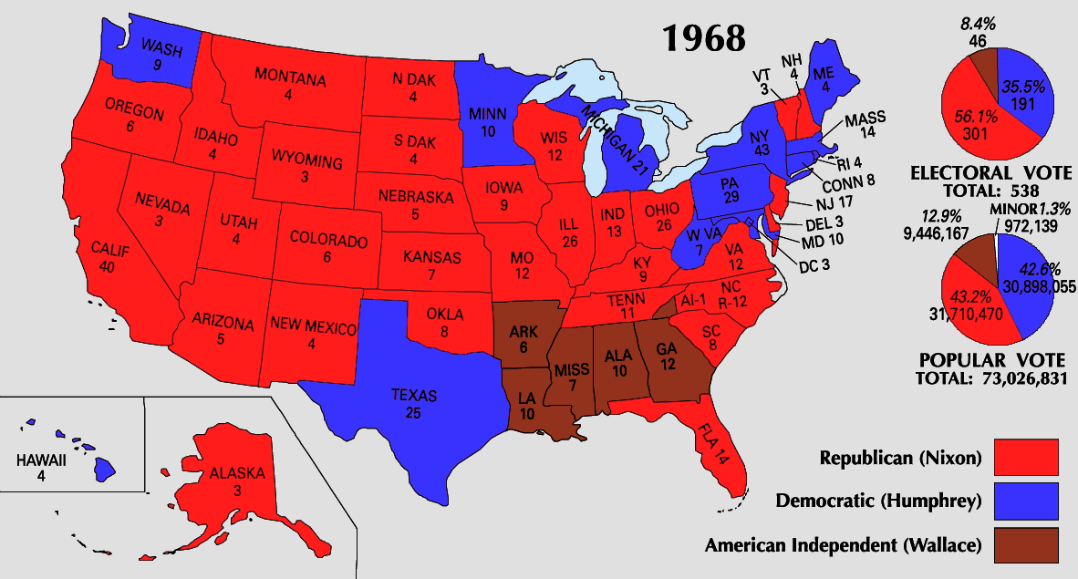
The Election of Richard Nixon
Nixon’s victory in 1968 was due to the turnout of a “silent majority” who wanted a more conservative gov’t
In 1968, Americans elected conservative Republican Richard Nixon

Slide 5
Richard Nixon & Domestic Policy
As a conservative, Nixon believed in a limited role for the national gov’t
He tried to reduce or eliminate many Great Society programs
He gave states more control over how money for welfare programs was spent

Slide 6
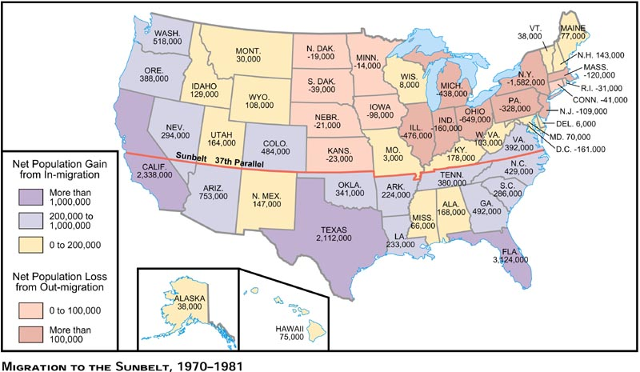
Richard Nixon & Domestic Policy
By the late 1960s, the South was becoming more conservative due to new military bases & corporate headquarters, the relocation of retirees, & frustration by whites over civil rights
Nixon seized the opportunity to attract Southerners to the Republican Party by opposing new civil rights policies & cutting government spending

Slide 7
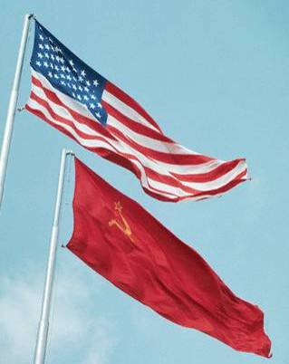
Richard Nixon & Foreign Policy
President Nixon successfully changed U.S. foreign policy
Instead of using containment to fight Communism & increase Cold War tensions, Nixon created a policy of détente (to ease tensions) with America’s Cold War enemies

Slide 8
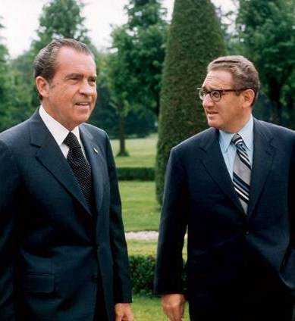
The Presidency of Richard Nixon
President Nixon successfully changed U.S. foreign policy
President Nixon & aide Henry Kissinger used a strategy called triangular diplomacy to improve America’s role in the world

Slide 9
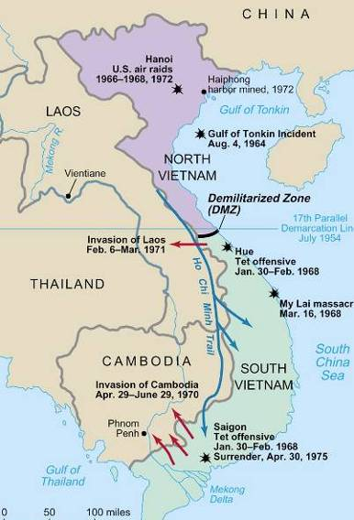
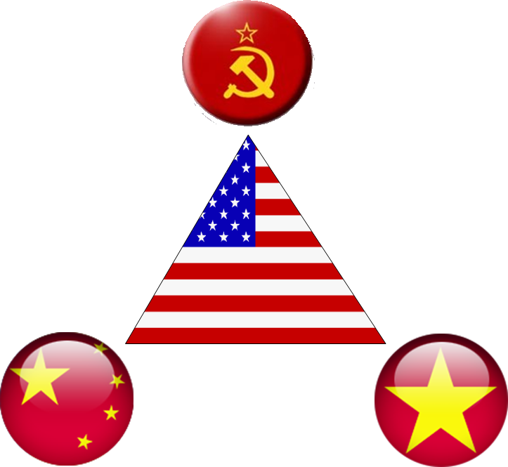
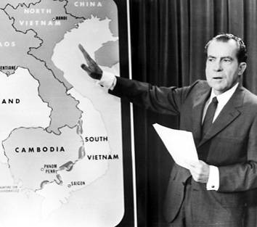
Richard Nixon & Foreign Policy
Nixon’s foreign policy included “peace with honor” in Vietnam
Nixon discussed plans for “Vietnamization” but secretly bombed Cambodia & Laos in 1970
In 1973, Nixon negotiated a cease fire, withdrew U.S. troops, & ended the Vietnam War

Slide 10
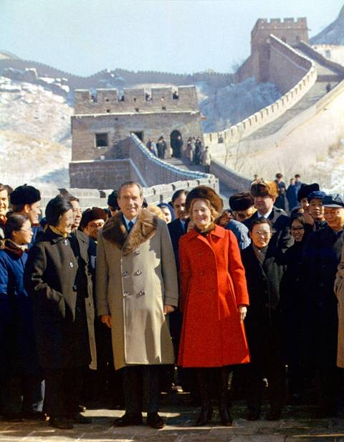
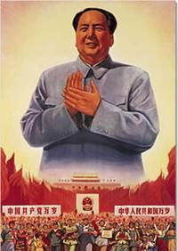
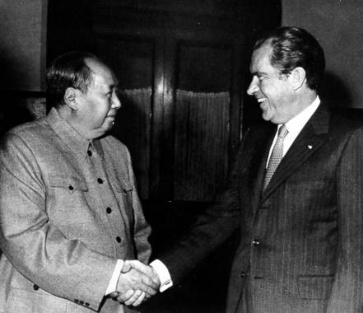
Richard Nixon & Foreign Policy
Nixon’s foreign policy included better relations with China
In 1972, Nixon became the 1st president to visit & recognize China
Nixon’s visit to China was also meant to exploit a growing rift between USSR & China; Now the USSR had to cooperate with the U.S.
Nixon’s visit allowed for the possibility of U.S. trade with China

Slide 11
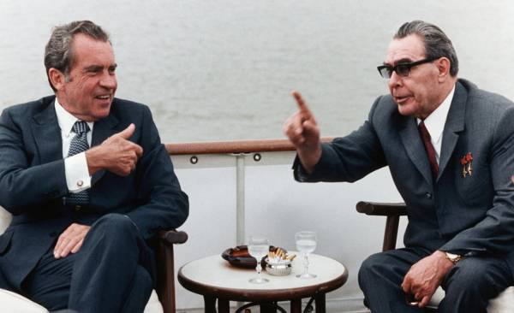
Richard Nixon & Foreign Policy
Nixon’s détente policy was aimed at easing Cold War tensions with the USSR
In 1972, Nixon became the 1st president to visit Moscow; His visit led to the Strategic Arms Limitation Talks (SALT) to limit ICBMs
By visiting China, Nixon pressured Soviet leader Brezhnev to negotiate with the United States

Slide 12
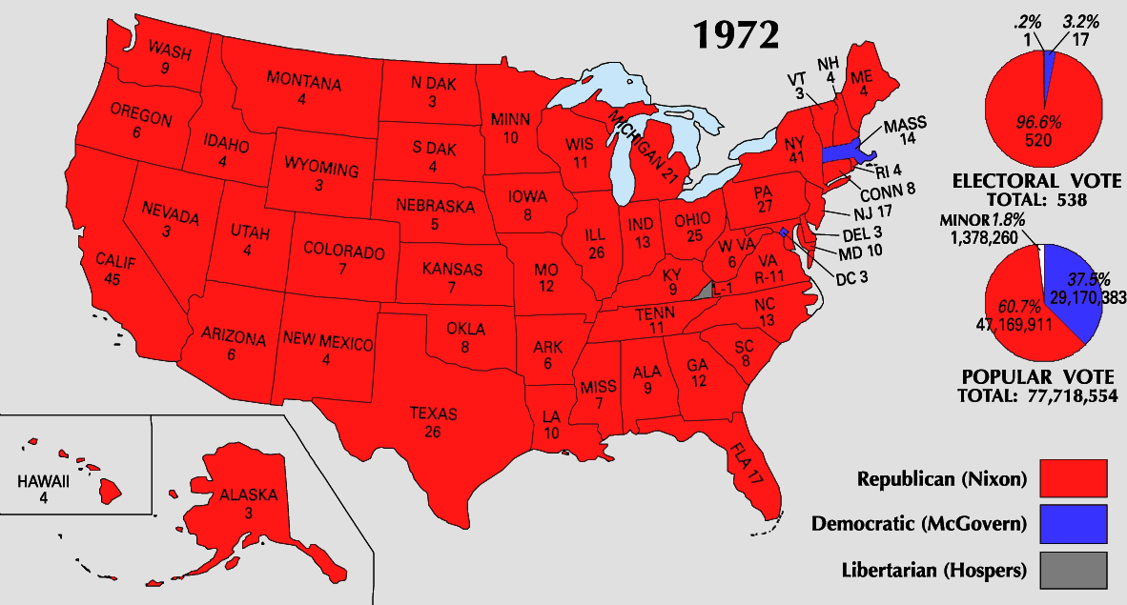
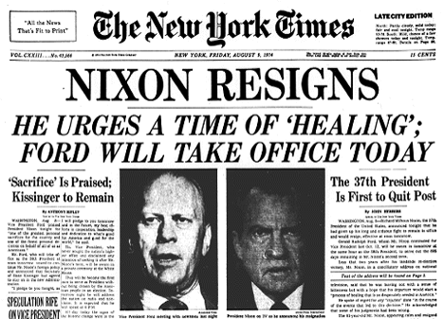
The Presidency of Richard Nixon
Nixon was a popular president by the end of his 1st term
His domestic policies reduced gov’t spending & revitalized middle-class, conservative, & Southern voters
His foreign policies led to the end of an unpopular war in Vietnam & eased tensions with America’s two biggest Cold War rivals
In 1972, Nixon won one of the biggest landslide victories in presidential history
But after Nixon’s re-election in 1972, the Watergate scandal broke; President Nixon resigned in 1974 rather than face impeachment
Notes:
http://safeshare.tv/w/XpcEYVeAoM

