Slide 1
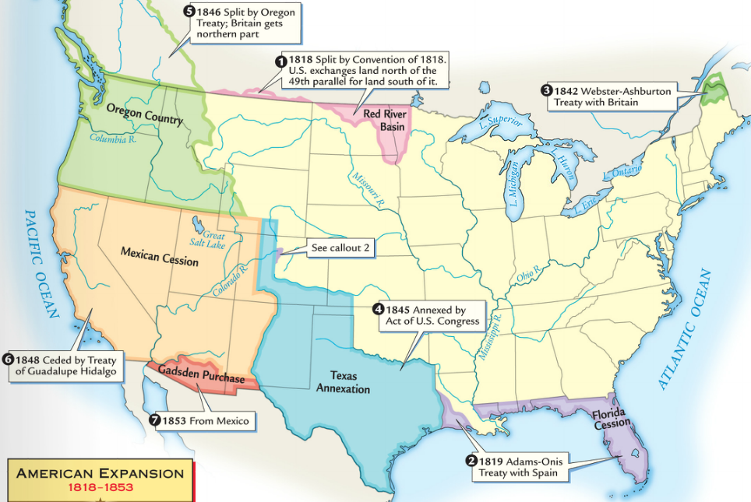
In the 1840s, America realized its “manifest destiny” by acquiring all lands to the Pacific Ocean
In 1845, the USA annexed the independent nation of Texas
In 1846, the U.S. settled a dispute with England to gain Oregon
In 1848, the USA gained new lands in the SW by winning the Mexican- American War

Slide 2
Texans, led by Sam Houston won their independence from Mexico in 1836

Slide 3
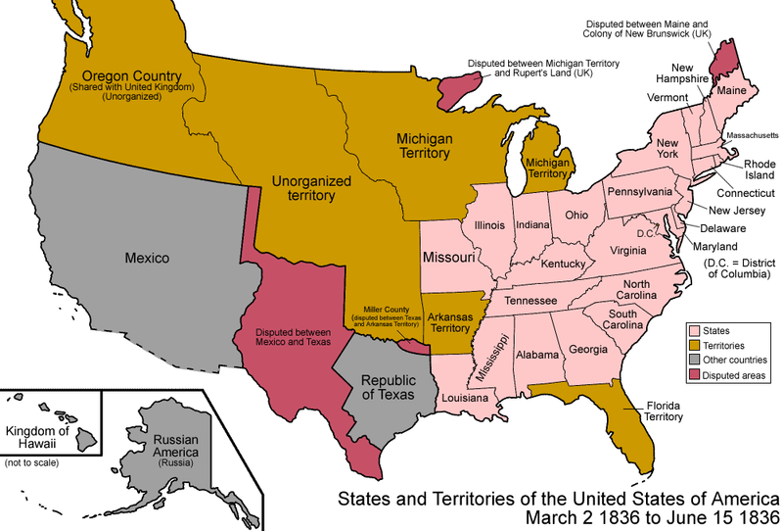
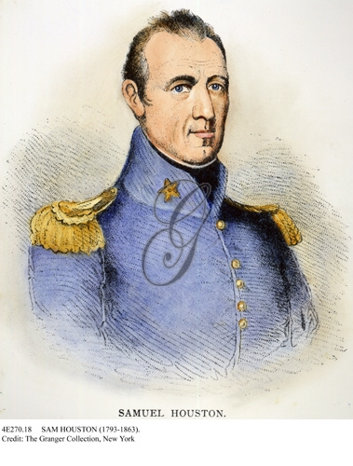
From 1836 to 1845, Texas was an independent nation; Sam Houston was the first president of the Republic of Texas
In 1838, Houston invited the USA to annex Texas, but the debate over slavery kept America from adding Texas as a state

Slide 4
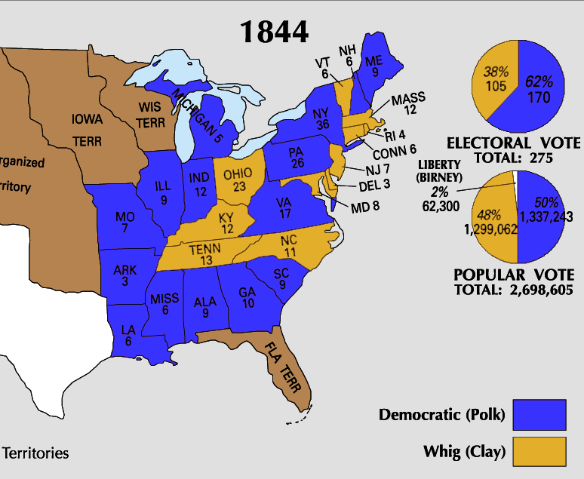
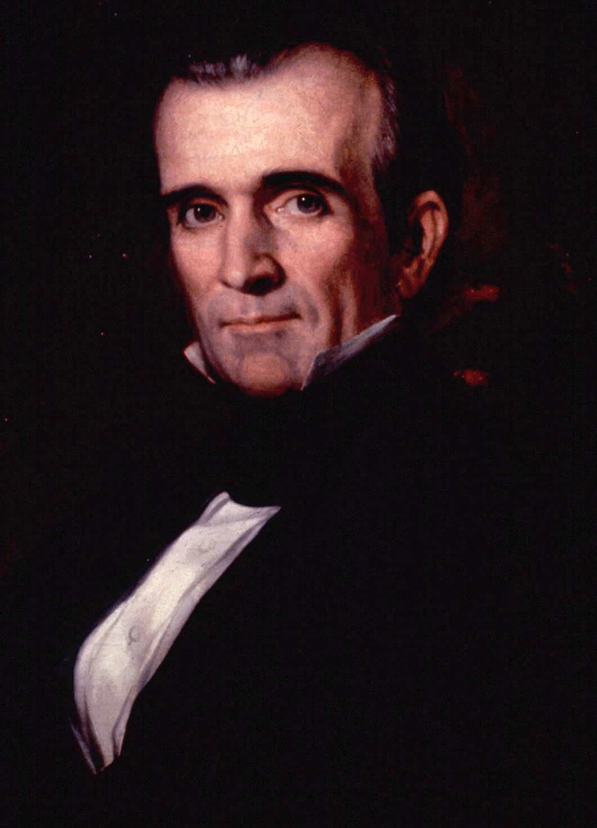
Democrat James K. Polk won the election of 1844 and became the “Manifest Destiny” president
He urged Congress to make Texas the 28th U.S. state in 1845
He wanted to end British claims to Oregon

Slide 5
When Texas was admitted into the Union in 1845, it came in as a slave state
To make Northerners happy, President Polk wanted to add Oregon as a free state, but…

Slide 6
…Oregon was jointly occupied by the USA & Britain
Ultimately, the U.S. and Britain agreed to divide Oregon along 49° parallel, and Oregon became a free territory in 1846
Oregon residents & President Polk demanded the entire Oregon territory: “54°40’ or fight!”

Slide 7
When Texas won its independence from Mexico in 1836, the 2 sides disagreed over the territorial borders of the Republic of Texas

Slide 8
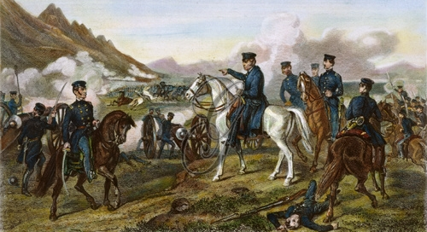
The Mexican-American War (1846—1848)
This dispute led to the Mexican-American War from 1846 to 1848
In 1846, President Polk sent General Zachary Taylor across the Rio Grande River which provoked Mexico into war

Slide 9
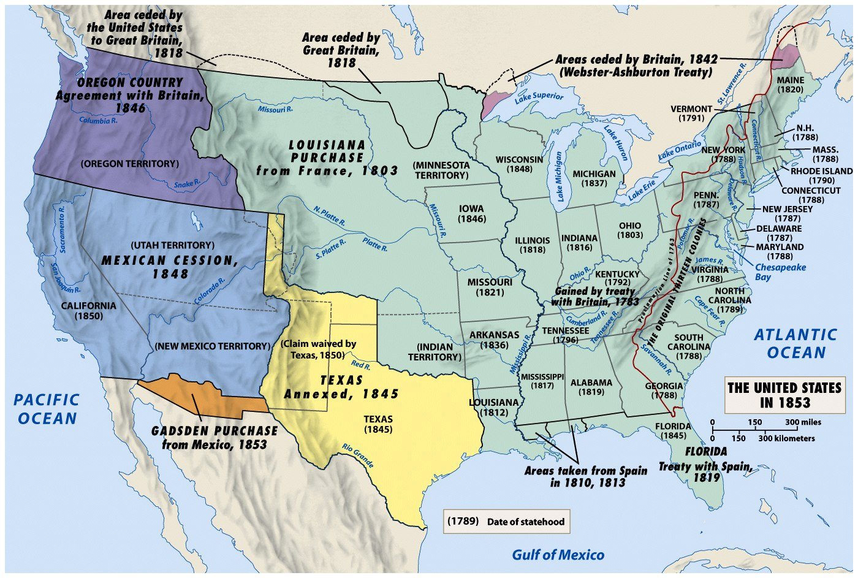
The Mexican-American War ended with the Treaty of Guadalupe-Hidalgo in 1848
The USA gained
all of Texas to the Rio Grande River
Mexico gave up (ceded) territory in the Southwest, called the Mexican Cession
5 years later, the U.S. bought the Gadsden Purchase for $10 million to build a southern railroad

Slide 10
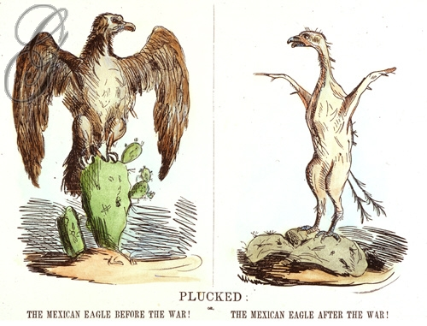

Slide 11
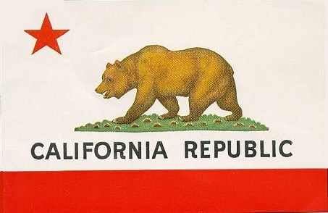
In the 1830s, Mexico offered cheap land to American ranchers & farmers to move to California
1846: Californians revolted from Mexican rule and created an independent nation
The California Republic was annexed by the USA as part of the Mexican Cession in 1848

Slide 12
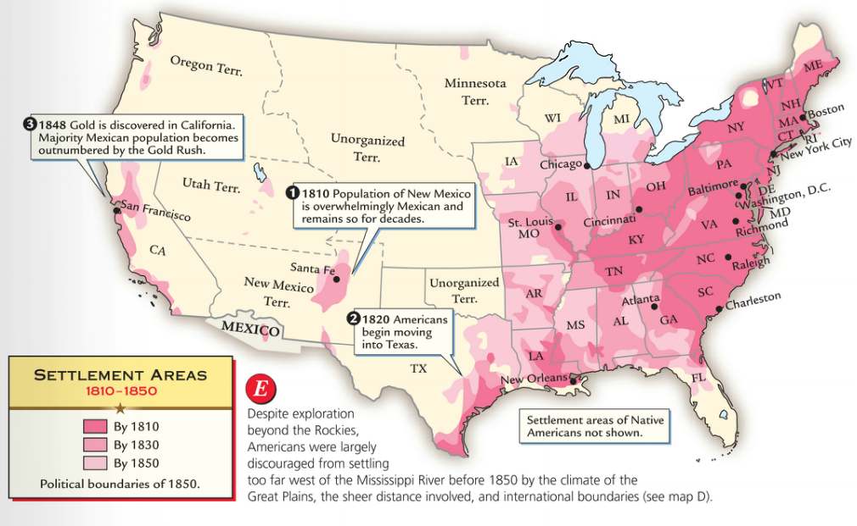
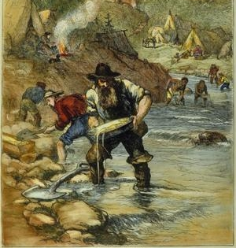
The discovery of gold in San Francisco led to a flood of Americans to California in 1849
“Forty-Niners” hoping to strike it rich came from the East, Latin America, Europe, & Asia

Slide 13
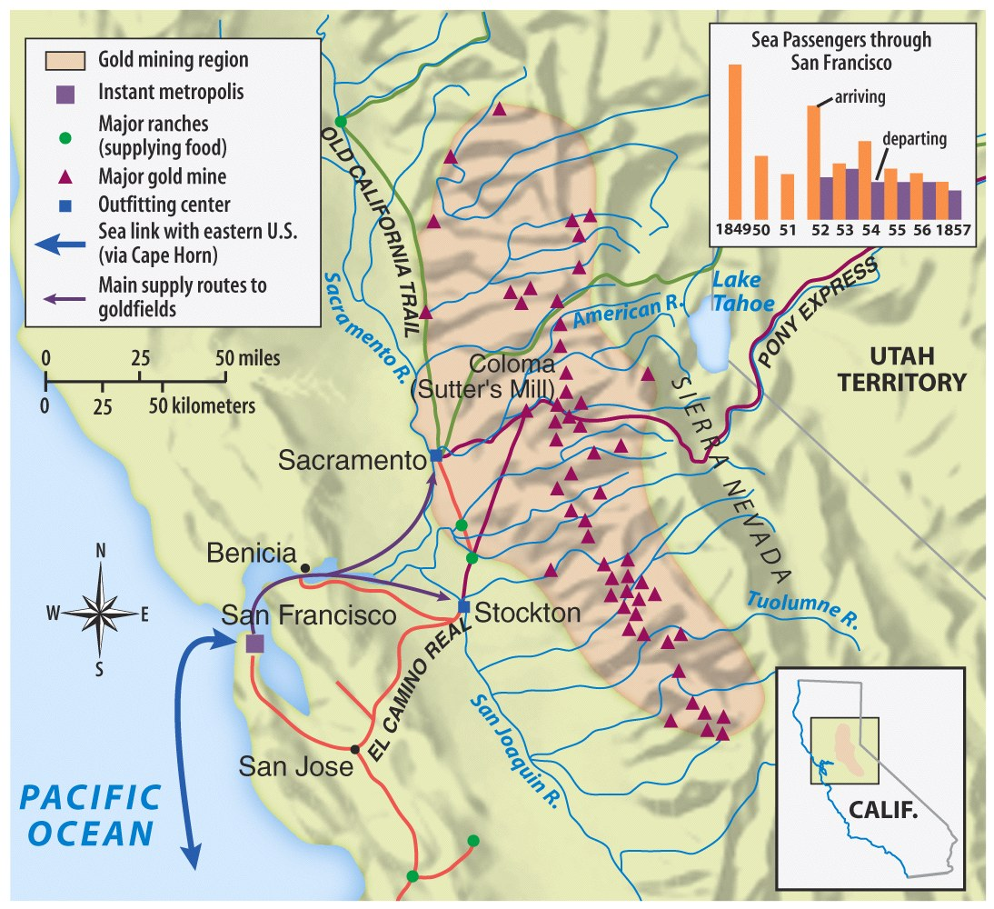
The California gold rush led to a population boom in the West

Slide 14
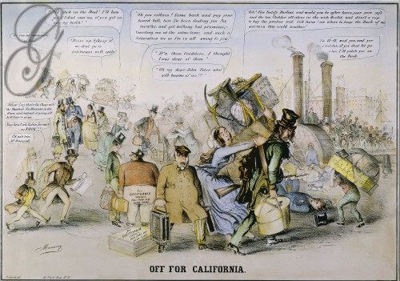
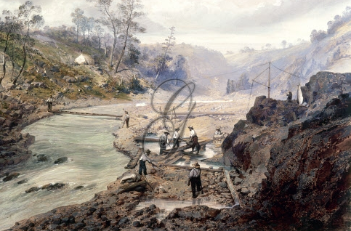
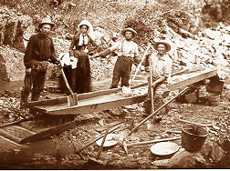
Gold Fever & Immigration to CA was national

Slide 15
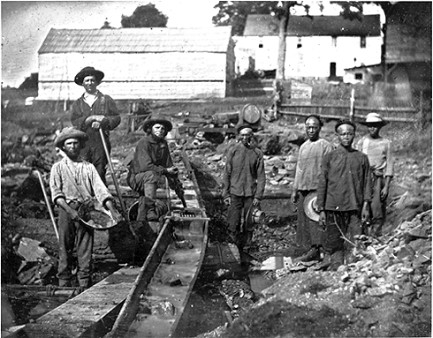
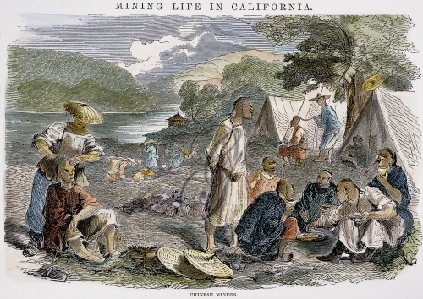
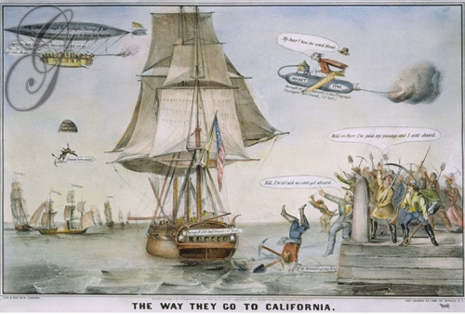
Where the 49ers Came From
Gold Fever & Immigration to CA was Global

Slide 16
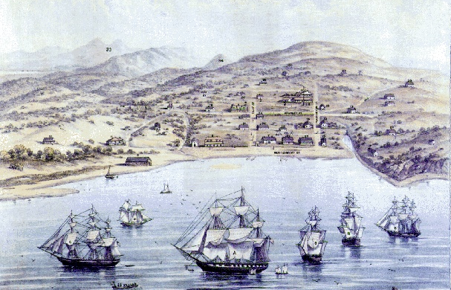
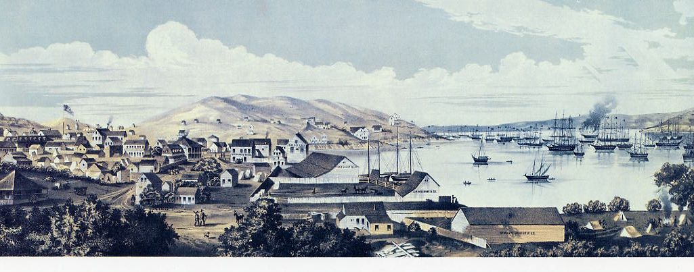
San Francisco before the gold rush
San Francisco after the gold rush

Slide 17
By the end of the 1840s, the USA had achieved its Manifest Destiny
America had a “continental” empire from the Atlantic to Pacific
Westward expansion stimulated the economy, spread democracy, and increased U.S. nationalism
But as America spread West, sectional issues over slavery grew

Slide 18
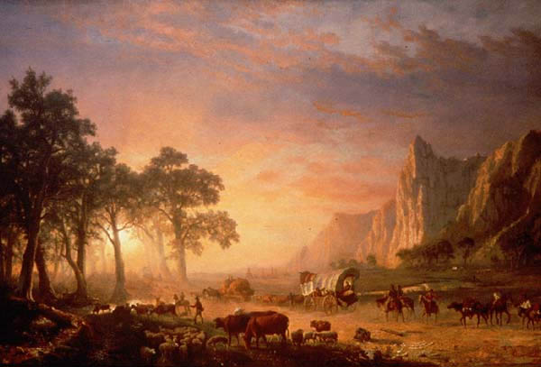
America: The Story of Us Western expansion

