Slide 1
Fact or Fabrication?
*Wednesday’s BellRinger:
Read each statement.
Decide if it’s a fact or a fabrication
Explain WHY – defend your answer.
The first Thanksgiving was in 1621 and the pilgrims celebrated it every year thereafter.
The original Thanksgiving feast took place on the fourth Thursday of November.
The pilgrims wore only black and white clothing. They had buckles on their hats, garments, and shoes.
The pilgrims brought furniture with them on the Mayflower.
The Mayflower was headed for Virginia, but due to a navigational mistake it ended up in Cape Cod Massachusetts.

Slide 2
Formatting: Vocab NotecardS
KEY TERM/VOCAB WORD
Information
Memory
Clue
Front of Notecard
Back of Notecard

Slide 3
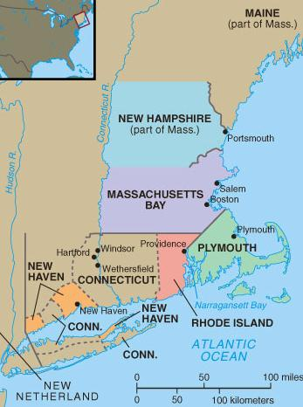
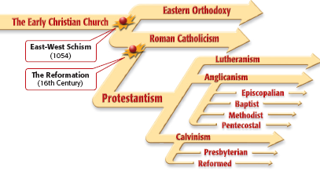
The colonists who first settled in
New England came for religious reasons
Religious disagreements
in Britain led to divisions
in the Anglican Church

Slide 4
Puritans believed in
the Calvinist idea of predestination & tried
to live strictly “Christian” lives without sin
Puritans believed that
the Anglican Church compromise too far
by allowing some
Catholic rituals

Slide 5
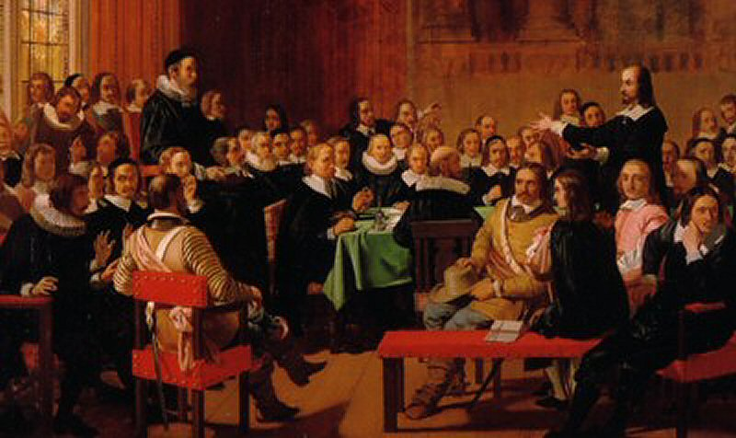
All Anglicans
Puritans
Separatists
Some radical Puritans were known as Separatists because they unwilling to wait for church reforms

Slide 6
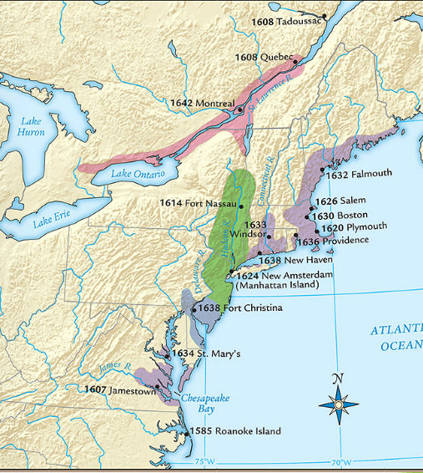
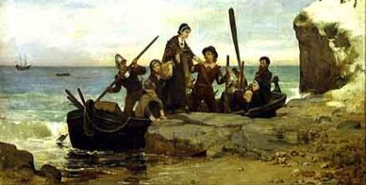
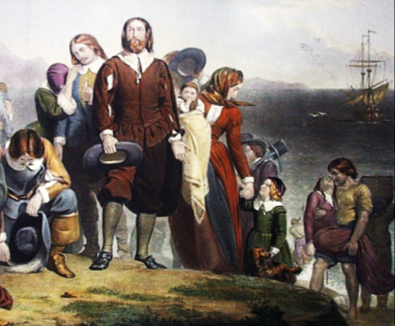
The Separatists became “Pilgrims” when they formed a joint-stock company, gained a charter,
& created the Plymouth colony in America

Slide 7
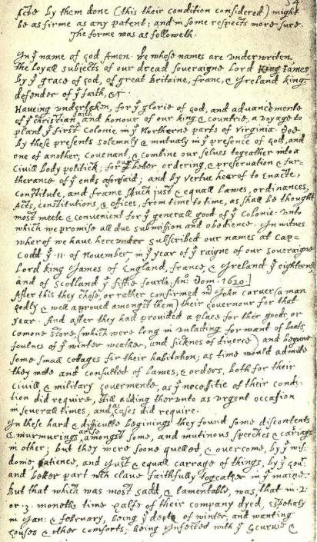
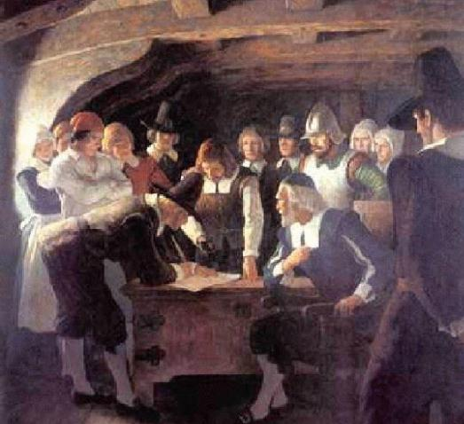
Before landing in America, the Pilgrims created the Mayflower Compact agreeing to work together
as a “civil body politick”…
…The Mayflower Compact was the first example of
self-government in America

Slide 8
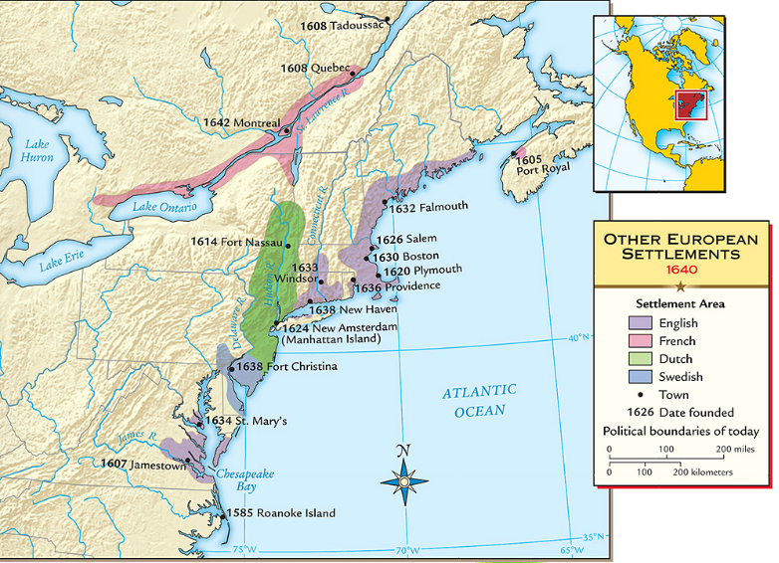
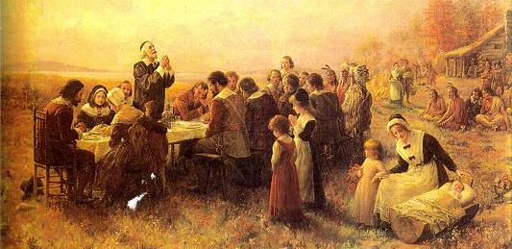
When the Pilgrims founded Plymouth in 1620,
they faced disease & hunger
The Pilgrims received help from local natives like Squanto & Massasoit…
…and celebrated the first Thanksgiving to honor the local Indians

Slide 9
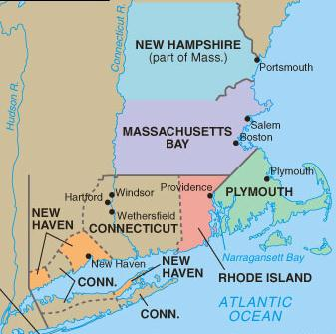
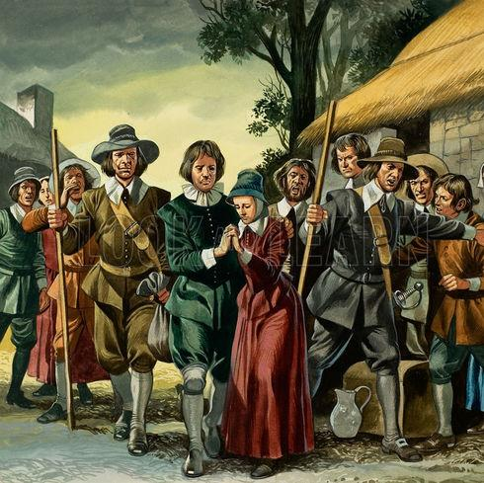
When the Separatist Pilgrims came to America, the Puritans remained within the Church of England
But when
the Catholic
King Charles I came to power, Puritans felt the time was right to leave Britain
In 1630, Puritans arrived in Boston & created the New England colony of Massachusetts

Slide 10
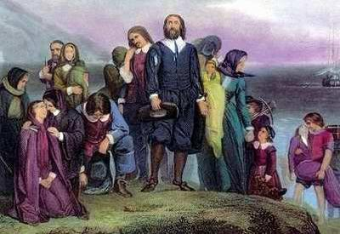
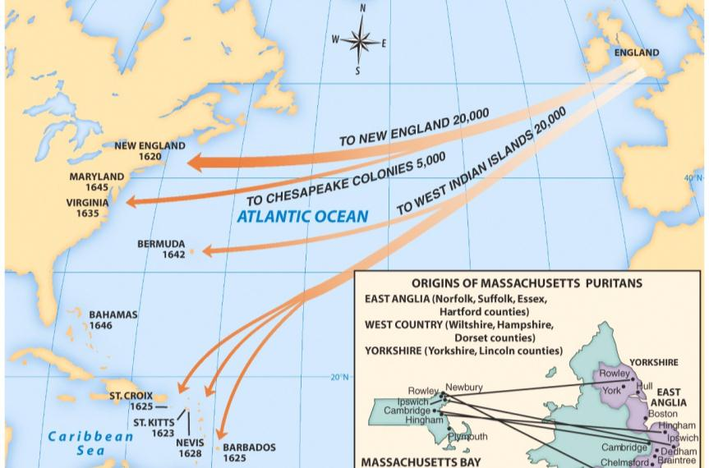
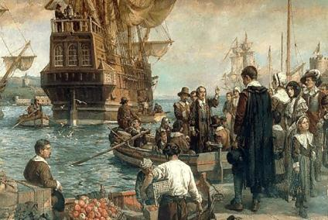
  From 1630 to 1640, Puritan leader John Winthrop led 16,000 Puritans to the Massachusetts Bay colony as part of the “Great Migration”
  John Winthrop wanted to build Boston as a
  “city on a hill” to be a model to other Christians

Slide 11
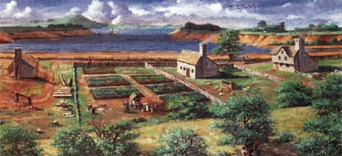
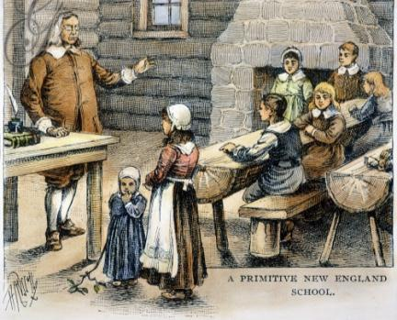
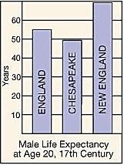
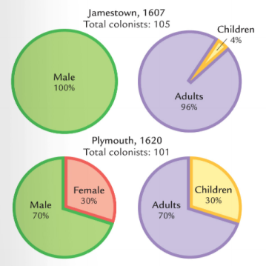
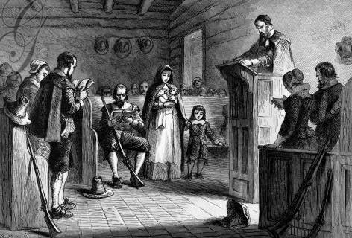
Quick discussion: Based on these images, how were the New England colonies different from Virginia?

Slide 12
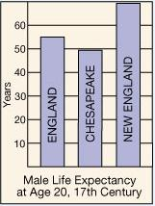
  Massachusetts was a different colony from Virginia:
Puritans came to America for religious freedom
Puritan settlers usually came as families
Settlers sacrificed for the common good, built schools, & focused on subsistence farming
New England was a more healthy place to live than Virginia so colonists lived longer

Slide 13
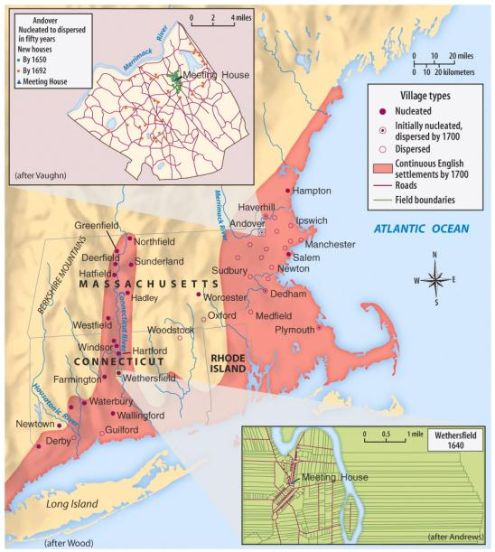

Government in in the New England colonies centered on the church through town meetings
Each New England town was independently governed by local church members
All adult male church members were allowed to vote for local laws & taxes
Notes:
Government in Massachusetts centered on the church through town meetings:
Each Massachusetts town was independently governed by local church members

Slide 14
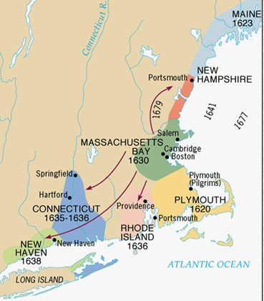
As the Massachusetts colony grew,
it spawned four new colonies:
New Hampshire, Rhode Island,
New Haven, & Connecticut
Connecticut
was important
for creating the first written constitution in
U.S. history called The Fundamental
Orders of Connecticut

Slide 15
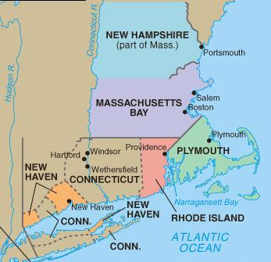
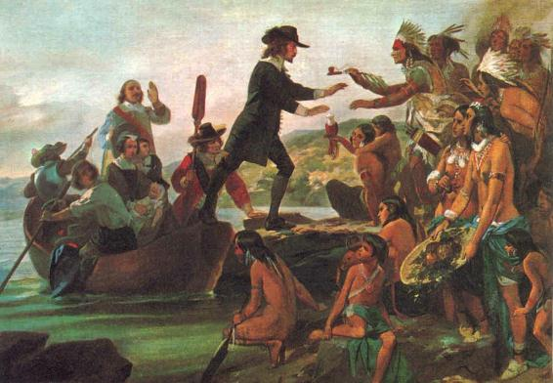
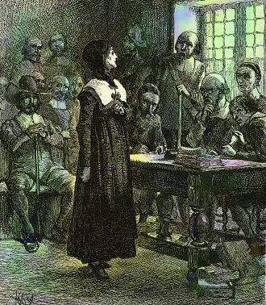
New England Puritans did not like ideas that differed from their own beliefs
Roger Williams was banished from Massachusetts for demanding that Indians be paid for their land;
He formed Rhode Island in 1636
Anne Hutchinson was banished for challenging Puritan authority

Slide 16
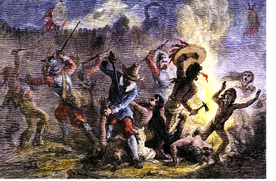
As the New England colonies expanded into new lands, conflicts with Indians arose
The Pequot War in 1637 was the 1st major British-led attack on Indians & led to the death of 600 Indians

Slide 17
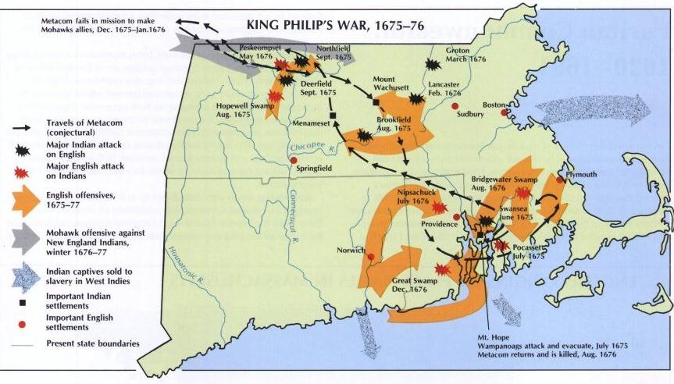
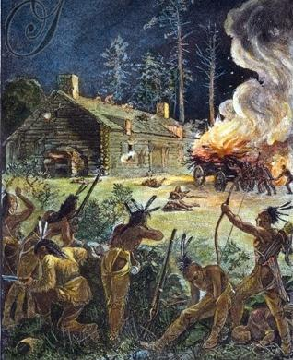
King Philip’s War broke out in 1675 when
the Wampanoag Indians raided towns,
killing 10% of the colonial New England men

Slide 18
By the 1660s,
many New England towns experienced a drop-off in
church membership
Churches responded with the Halfway Covenant which gave full church membership
to people who had not had a “conversion experience”
This compromise brought people back to the church, but showed the declining importance of religion in New England
Notes:
This compromise revealed the declining importance of religion in New England

Slide 19
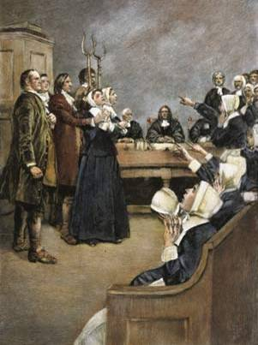
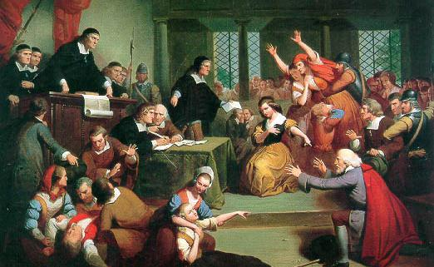
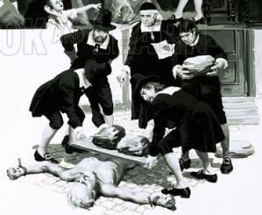
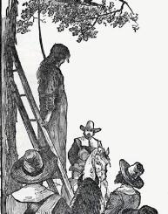
Religion played a role in the Salem
witchcraft trials in 1692 when several
young girls accused people of being witches
The hysteria was caused
by tensions over land ownership, Indian attacks, & religious disagreements
As a result of the trials,
19 people were killed & 150 citizens were jailed

