Slide 1
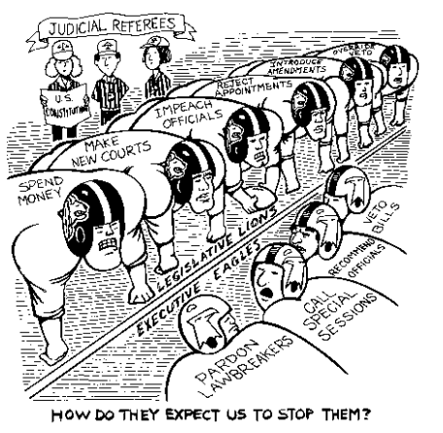
Marbury vs. Madison
BellRinger 10/9:
Analyze the cartoon below in terms of its meaning related to the Marbury v. Madison case.
What do you see in the cartoon? Make a list of objects, people, and any characteristics that seem to be exaggerated.
Which of the items on the list from Question 1 are symbols? What does each symbol stand for?
What is happening in the cartoon?
What is the cartoonist's message?
Do you agree or disagree with the message? Explain your answer.

Slide 2
BellRinger 10/7
Goal: Evaluate Thomas Jefferson’s job as president. Consider his goals, beliefs and actions in your evaluation.
Task: Give him a letter grade based on his performance. Defend your grade with specific references to his beliefs, ideas and actions.

Slide 3
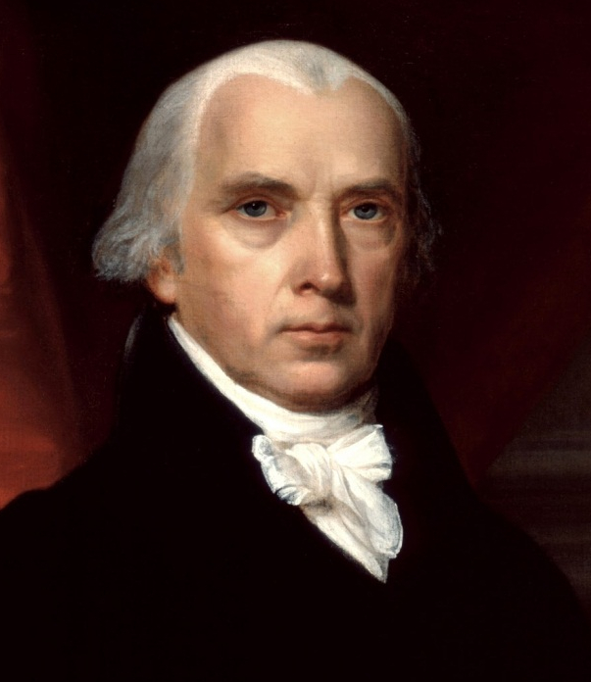
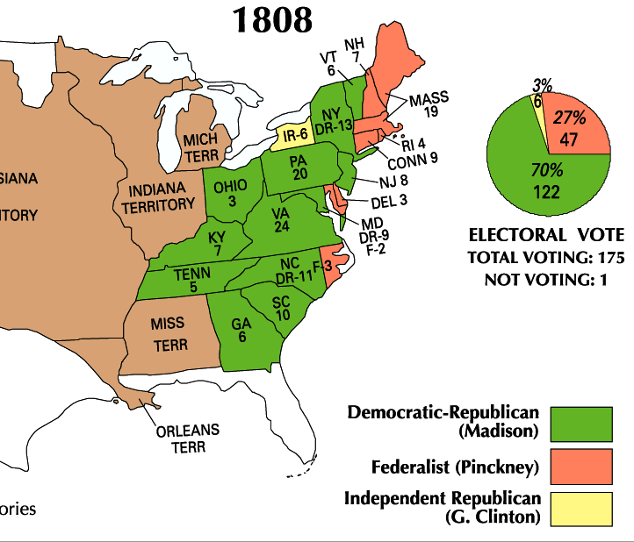
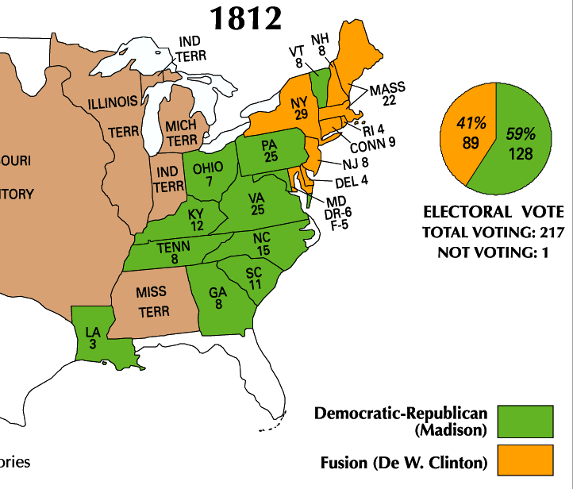
Jefferson’s hand-picked successor, James Madison, won the
presidency in 1808 & 1812
  Madison was well-qualified: He was the architect of the Constitution, served in Congress, & served as Jefferson’s Secretary of State

Slide 4
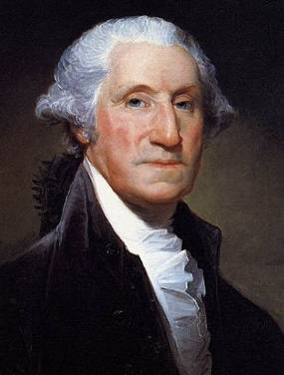
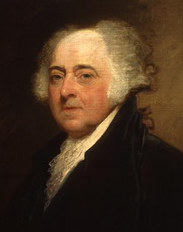
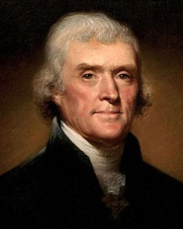
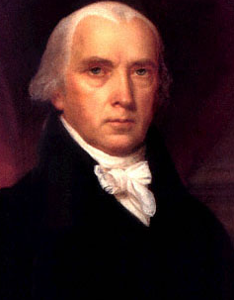
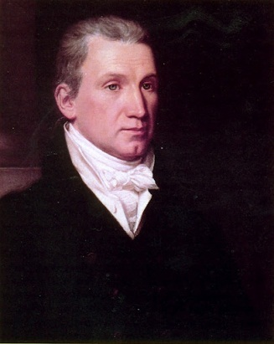
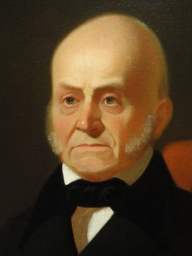
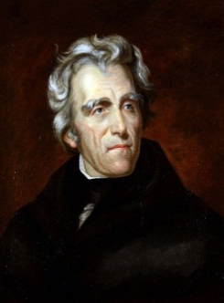
As president, Madison tried to continue Jefferson’s policies of limited national government
Madison continued the dominance of the Democratic-Republican Party & tried to continue Jefferson’s policies of limited national government
8 yrs
George Washington
(1789-1797)
4 yrs
John
Adams
(1797-1801)
8 yrs
Thomas
Jefferson
(1801-1809)
8 yrs
James
Madison
(1809-1817)
8 yrs
James
Monroe
(1817-1825)
4 yrs
John Quincy
Adams
(1825-1829)
8 yrs
Andrew Jackson
(1829-1837)
Federalist Party
Democratic-Republican Party
Democratic Party

Slide 5
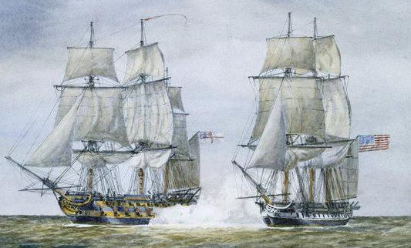
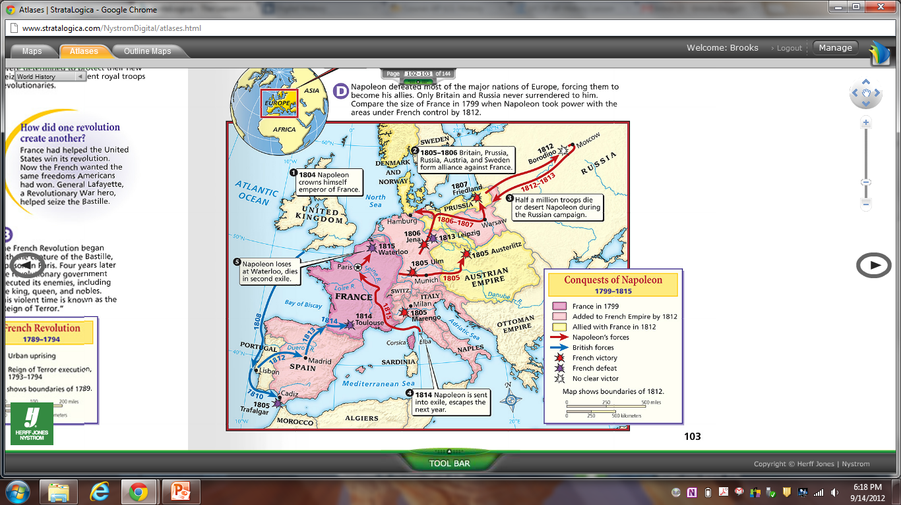
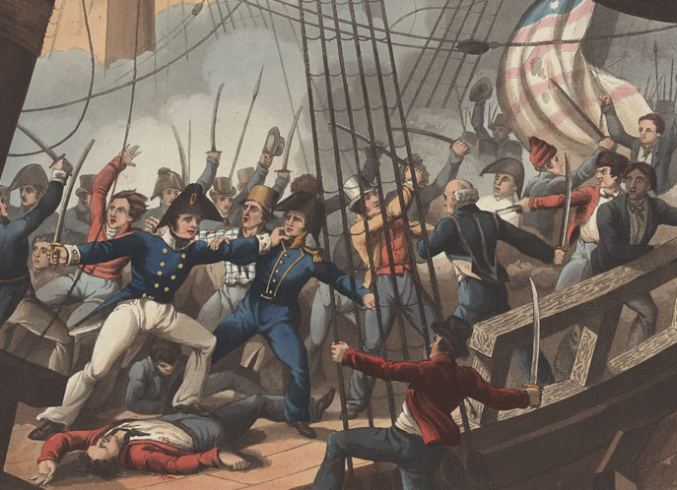
But, the
war between
England & France continued to cause America problems
England and France continued to violate American free trade
The British navy continued to
“impress” American merchants

Slide 6
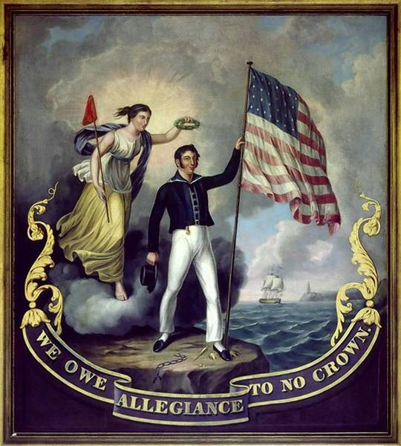
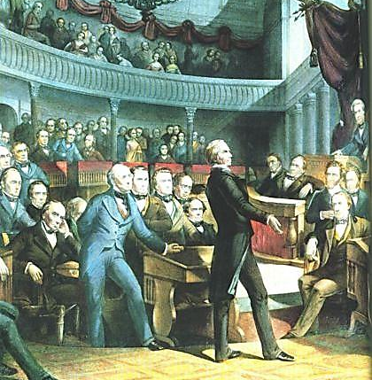
Many Congressmen called “War Hawks”
demanded war with Britain to defend U.S. honor
“Free Trade and
Sailors' Rights” was
a popular battle cry

Slide 7
Problem: Since 1793, Britain and France have been at war, violated free trade, and used impressment against American merchants. Attempts to resolve these issues did not solve these problems
Washington’s Proclamation
of Neutrality (1793)
Adams’ XYZ Affair (1798)
Jefferson’s embargo (1807)
Brainstorm three solutions
President Madison could use to solve this problem and select the 1 best alternative. Be sure to explain your decision

Slide 8
In 1812, Madison asked Congress for
a declaration of war against England
Patriotism surged
as Americans claimed the War of 1812 was a “Second American Revolution”

Slide 9
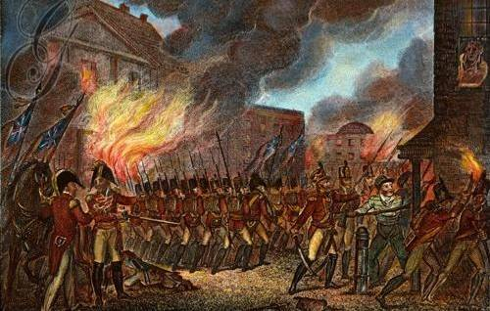
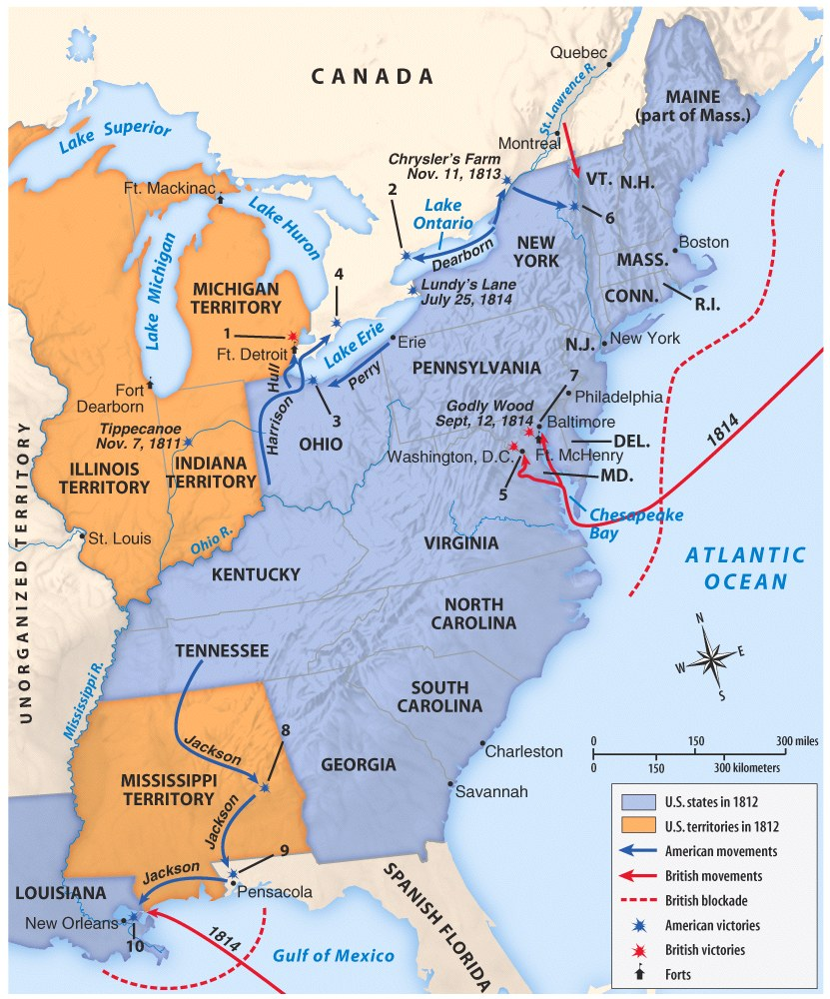
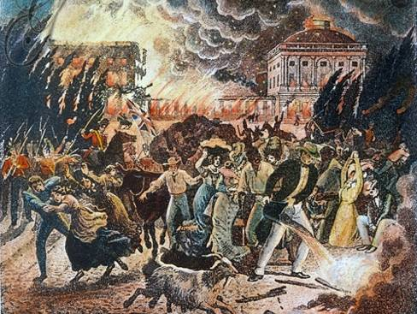

The War of 1812 (1812—1815)
The U.S. had a
small navy and
poorly trained army when the war began
Meanwhile, Britain’s
well-trained army had been fighting France for a decade
The war went badly in the early years
The British attacked and burned the national capital Washington, D.C.

Slide 10
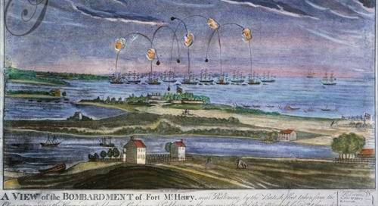
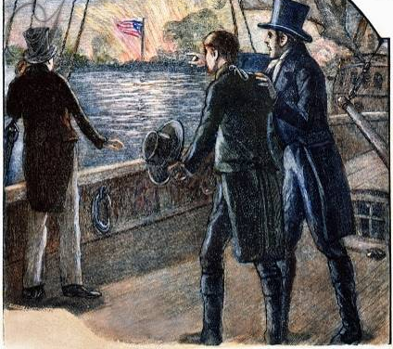
When the British laid siege to Fort McHenry, American Francis Scott Key wrote the poem “The Star Spangled Banner”

Slide 11
Though Britain was winning, they were also fighting France and wanted to
quickly end the War of 1812
In 1814, Britain and the United States signed the Treaty of Ghent ending the war

Slide 12
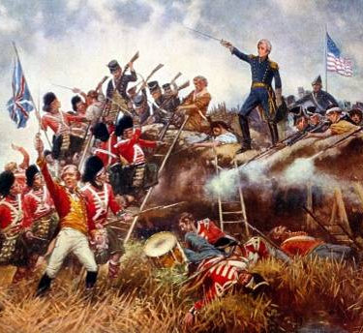
The War of 1812 (1812—1815)
Before news arrived, the Americans beat the British at the Battle of New Orleans
General Andrew Jackson emerged as a war hero
The victory at New Orleans led many Americans to feel as though they won the war

Slide 13
Battle of New Orleans—Johnny Horton (1959)
In 1814 we took a little trip
Along with Colonel Jackson down the mighty Mississip.
We took a little bacon and we took a little beans
And we caught the bloody British in the town of New Orleans.
[Chorus:]
We fired our guns and the British kept a'comin.
There wasn't nigh as many as there was a while ago.
We fired once more and they began to runnin' on
Down the Mississippi to the Gulf of Mexico.
We looked down the river and we see'd the British come.
And there must have been a hundred of'em beatin' on the drum.
They stepped so high and they made the bugles ring.
We stood by our cotton bales and didn't say a thing.
[Chorus]
Old Hickory said we could take 'em by surprise
If we didn't fire our muskets 'til we looked 'em in the eye
We held our fire 'til we see'd their faces well.
Then we opened up with squirrel guns and really gave 'em ... well

Slide 14
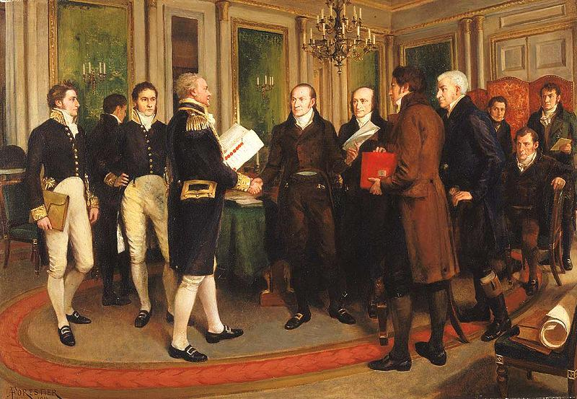
Treaty of Ghent ended the war, but it did not address trade rights or other causes of the war

Slide 15
The War of 1812
had important
effects on America
Americans were united in a sense of nationalism, believing that they had beaten the British
America entered
an “Era of Good Feelings” with a popular president
and booming
national economy

Slide 16
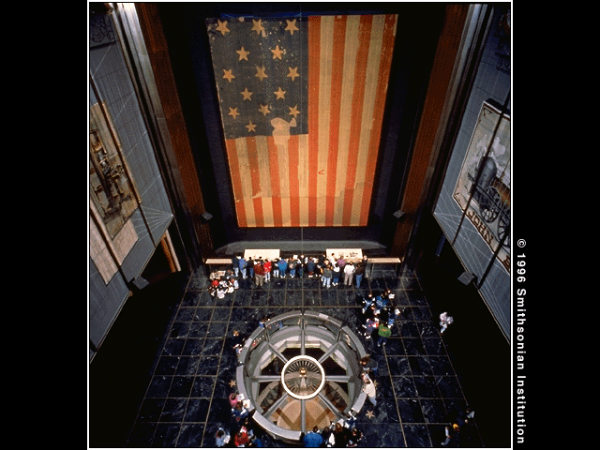
“Oh, Say Can You See?”
The 15 Star Flag became official flag of U.S. in May 1795
It flew over Fort McHenry (Baltimore) during War of 1812
Immortalized in the Star Spangled Banner, written by Francis Scott Key
Melody for the Star Spangled Banner
The Star Spangled Banner (1854)

Slide 17
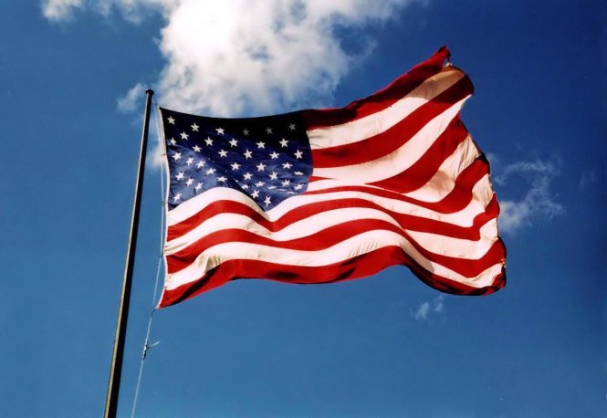
What Does the Flag Mean?
For each of the following images, write one sentence about what the image brings to mind about the flag and/or the United States
Closure Activity

Slide 18
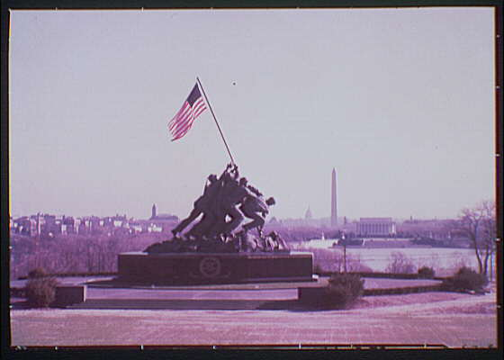
What Does the Flag Mean?

Slide 19
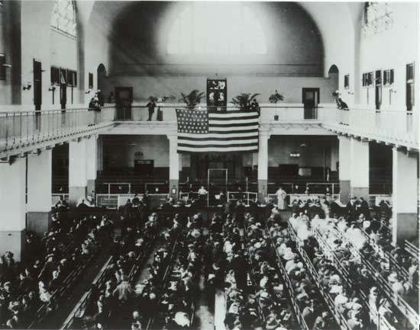
What Does the Flag Mean?

Slide 20
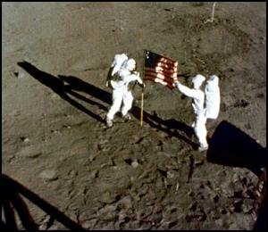
What Does the Flag Mean?

Slide 21
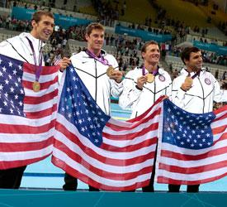
What Does the Flag Mean?

Slide 22
If time, show Presidents DVD here

Slide 23
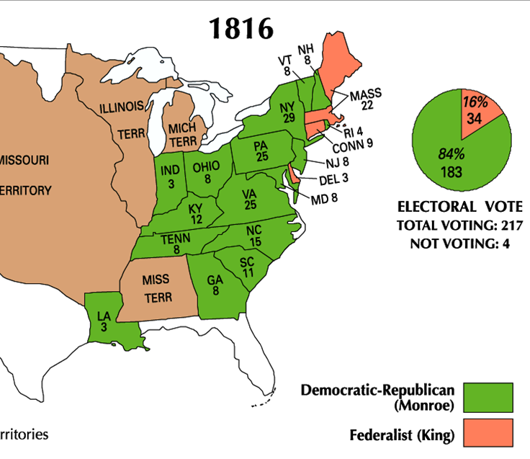
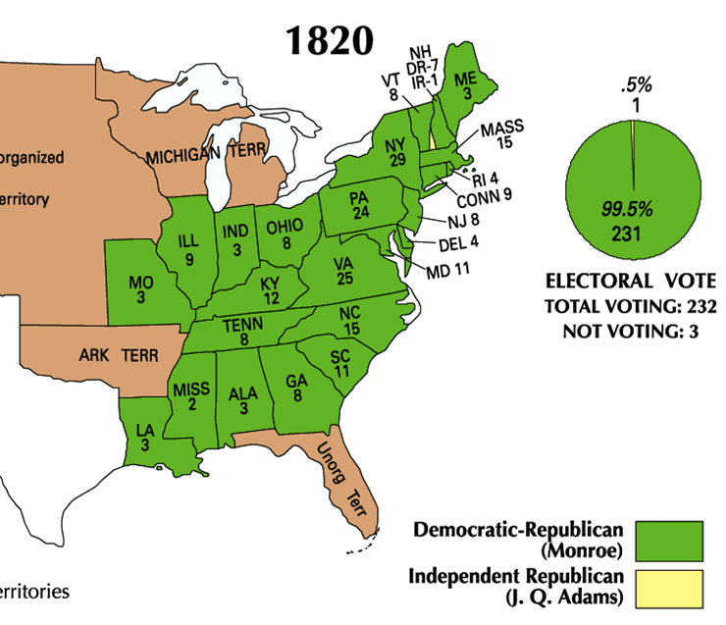
Bellringer 10/8
Study the maps below. List two FACTS we can learn from these maps and one INFERENCE (one thing we can assume…)

Slide 24
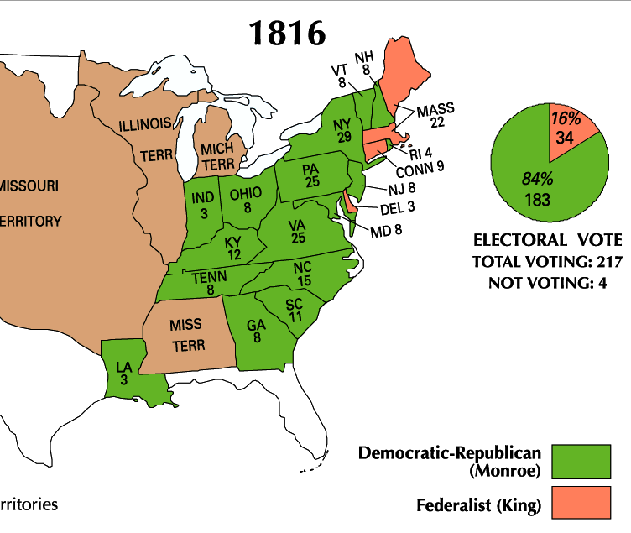
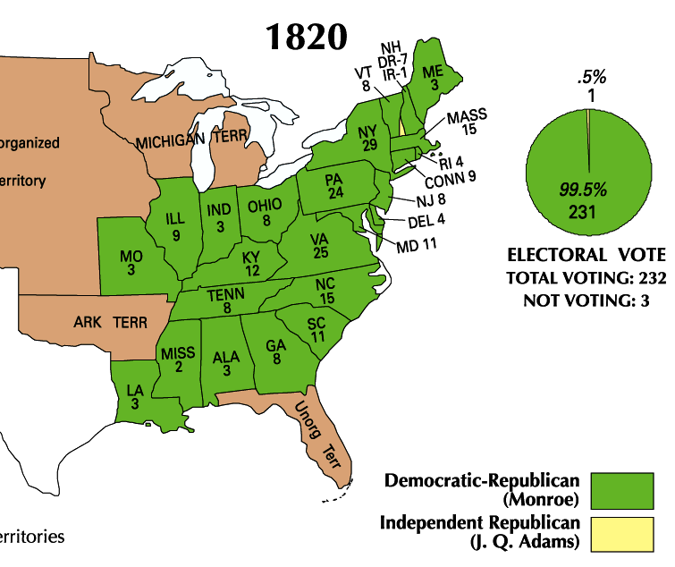
James Monroe was overwhelmingly elected president in 1816 and 1820
  Monroe’s presidency began during
  an era of increased nationalism
  after the War of 1812 known as the “Era of Good Feelings” (1815-1825)

Slide 25
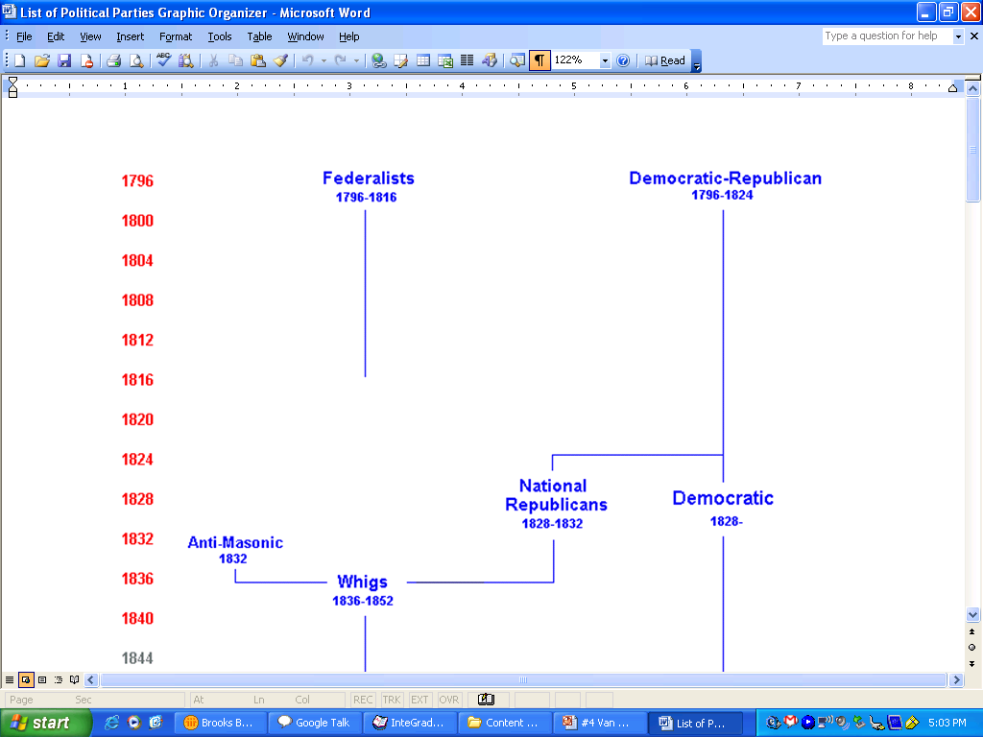
Monroe’s goals as president were to promote national unity and America’s place the world
By 1816 the Federalists
were so weak that the Democratic-Republicans could do almost anything
Monroe and the Republicans in Congress used this time to promote American nationalism
8 yrs
George Washington
(1789-1797)
4 yrs
John
Adams
(1797-1801)
8 yrs
Thomas
Jefferson
(1801-1809)
8 yrs
James
Madison
(1809-1817)
8 yrs
James
Monroe
(1817-1825)
4 yrs
John Quincy
Adams
(1825-1829)
8 yrs
Andrew Jackson
(1829-1837)
Federalist Party
Democratic-Republican Party
Democratic Party

Slide 26
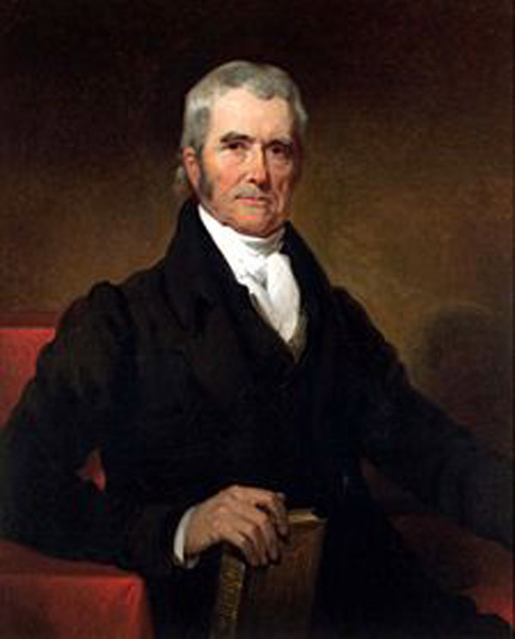
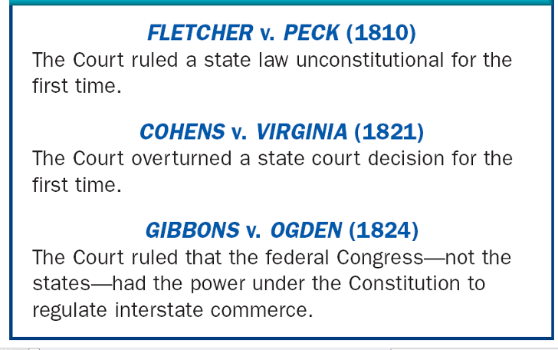
Monroe and the Republicans in Congress promoted nationalism & American unity in three ways:
Government: Increase the power of the national gov’t over the states
John Marshall (1801-1835) used the Supreme Court to strengthen the power of the national government

Slide 27
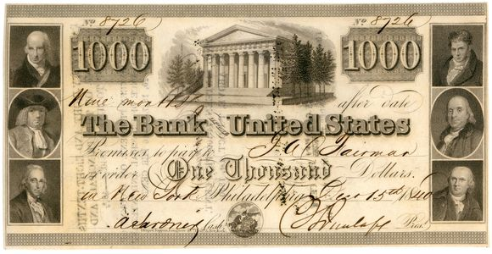
Monroe and the Republicans in Congress promoted nationalism & American unity in three ways:
Government: Increase the power of the national gov’t over the states
In 1816, Congressman
Henry Clay proposed
the American System to
unify the economies of the
North, South, and West
Economy: Encourage industry and transportation to link the South, North, and West
Create a Second Bank of the United States
Create a tariff to encourage industry and limit British manufactured goods
Improve transportation with roads and canals

Slide 28
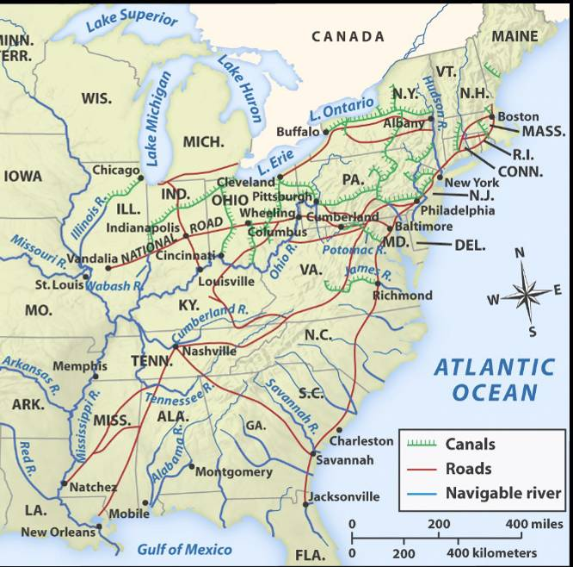
The American System allowed the USA to create
a national market economy for the first time
Western farms
grew grains
and raised livestock that fed the nation
Northern factories made manufactured goods that were sold throughout the country
Southern cotton was used in northern textiles factories
Notes:
We’ll talk about this “market revolution” more in-depth later this unit. This is just a preview in order to understand the importance of Henry Clay’s American System. The emphasis here is on the politics of the era, which should help students understand how the national government promoted a national market economy that, by the 1810s, had emerged as strong regional economies due to new technological innovations (cotton gin, interchangeable parts, Singer sewing machines, Slater mills, McCormick reaper, Deere steel plow, etc.) Again, we’ll discuss these details in the next set of notes.

Slide 29
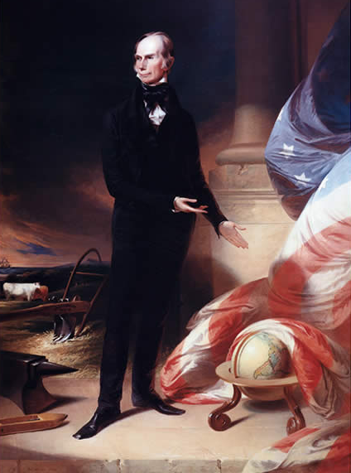
Kentucky Congressman Henry Clay
What aspects of
this portrait reveal parts of Henry Clay’s “American System”?

Slide 30
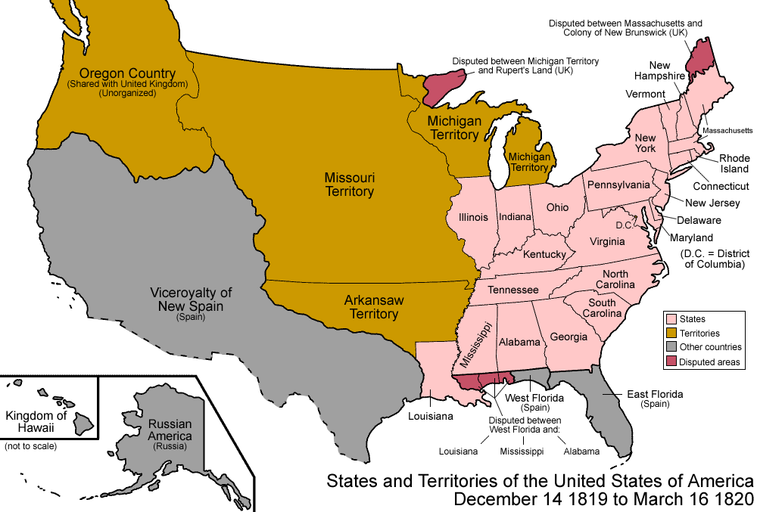
Monroe & the Republicans in Congress promoted nationalism & American unity in three ways:
Government: Increase the power of the national gov’t over the states
After the War of 1812, Americans flooded into the West; By 1840 over ¹/3 of the population lived in the West
Congress quickly admitted 5 new states to the Union
Economic and territorial growth created a need to settle America’s national borders
Economy: Encourage industry and transportation to link the South, North, and West
Indiana (1816)
Illinois (1818)
Alabama (1819)
Mississippi (1817)
Foreign Policy: Expanding America’s borders and increasing America’s role in world affairs
Louisiana (1812)

Slide 31
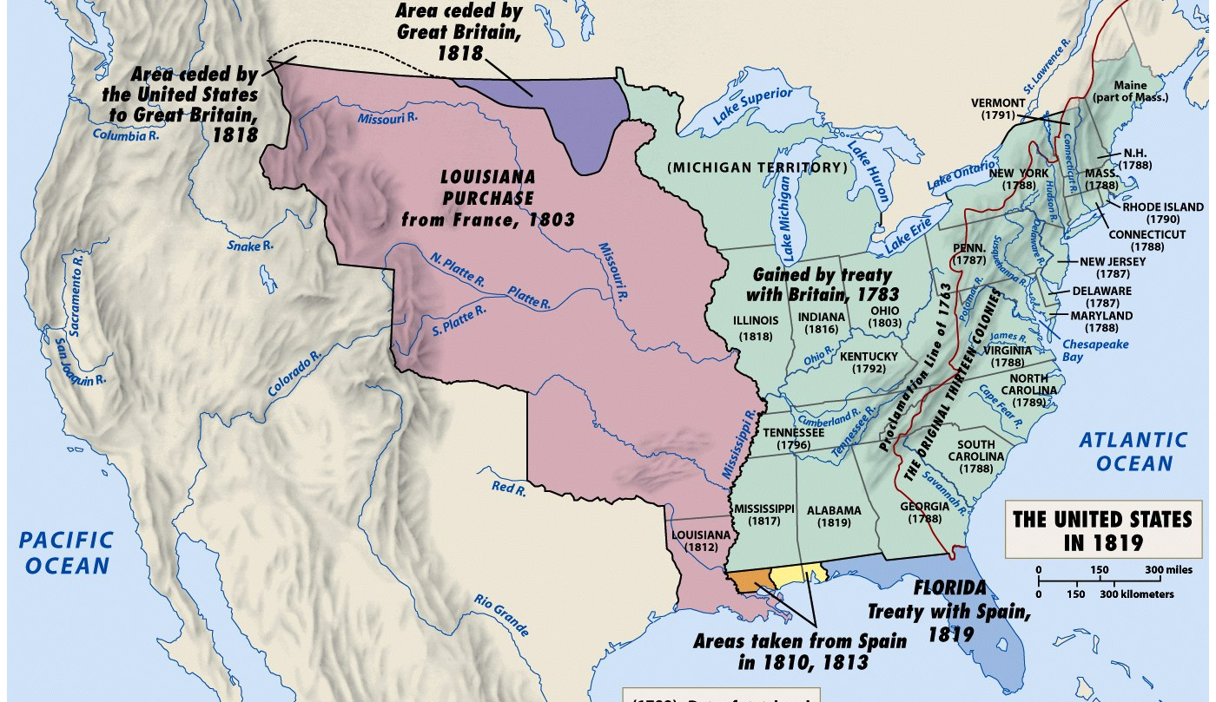
President Monroe and his Secretary of State
John Quincy Adams used foreign policy
to promote nationalism & territorial expansion
In 1818, the USA
and Britain agreed to establish the Canadian border at the 49°
In 1819 the USA gained
Florida from Spain with
the Adams-Onis Treaty

Slide 32
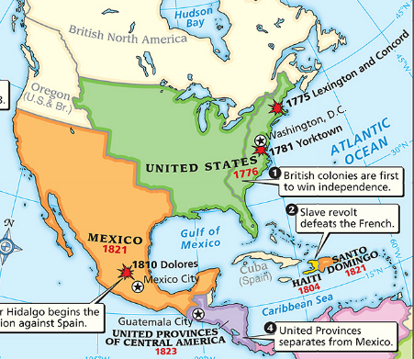
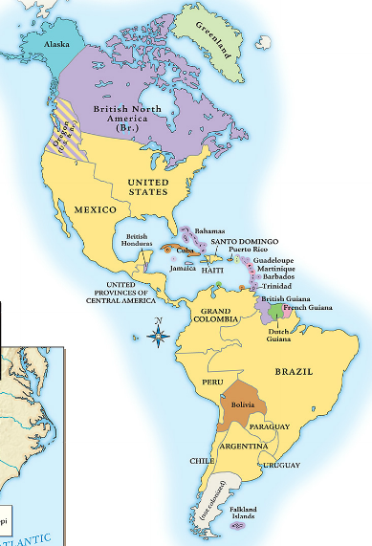
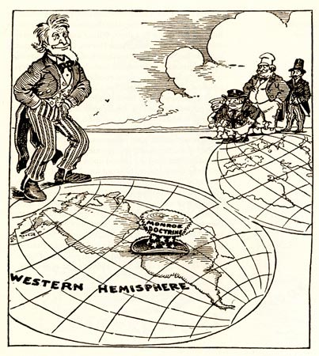
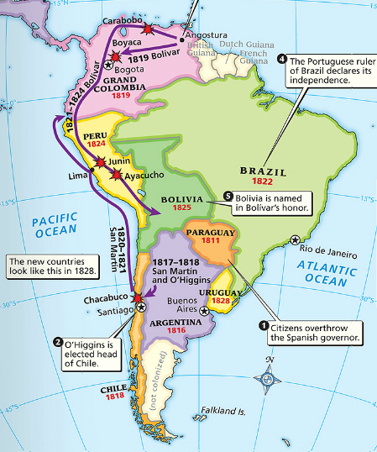
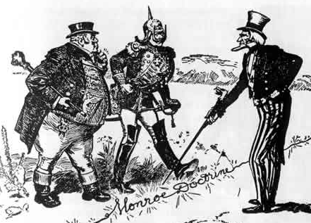
In 1823, the Monroe Doctrine warned European nations
that the USA would protect the Western Hemisphere and that the U.S. would not interfere in Europe
When Latin American nations gained independence, the USA wanted to support the
new republics and keep European nations from colonizing Latin America

Slide 33
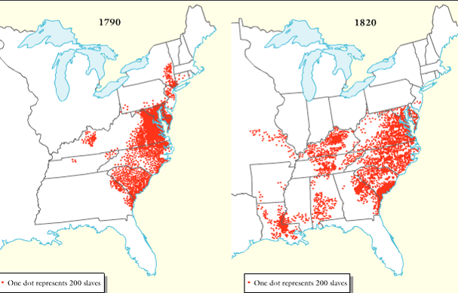
The Era of Good Feelings was a time of nationalism, but there were growing problems between the North and South (called sectionalism)
American Slave Population, 1790-1820

Slide 34
Northerners & Southerners disagreed over slavery, taxes, and the role of government
These disagreements dominated politics from 1820 to 1860
American Slave Population, 1790-1820

Slide 35
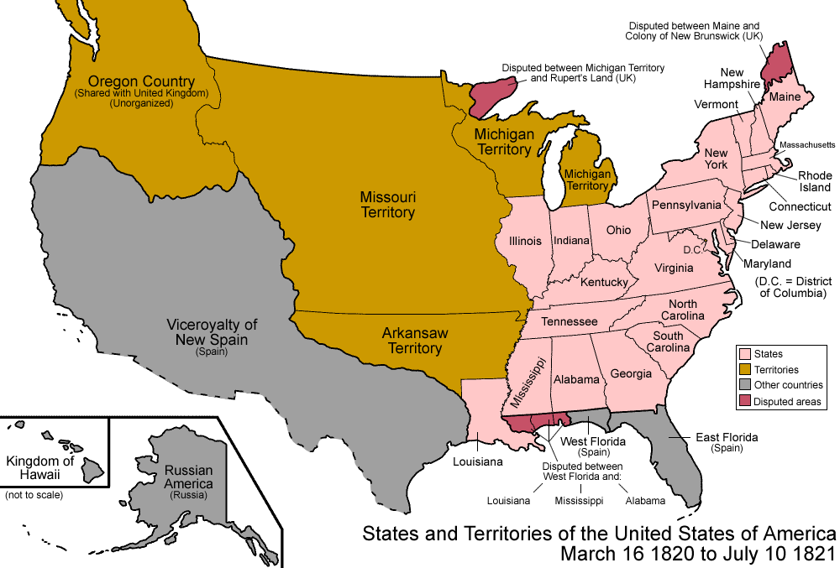
When Missouri applied to become a U.S. state, sectionalism emerged
Northerners did not want Southern states to increase power in the national gov’t
If Missouri entered as a slave state, the South would have
2 more Senators than the North
Notes:
Because of the 3/5 Compromise, the South had more members of the House of Representatives; President Monroe was from Virginia, so the South controlled the presidency too

Slide 36
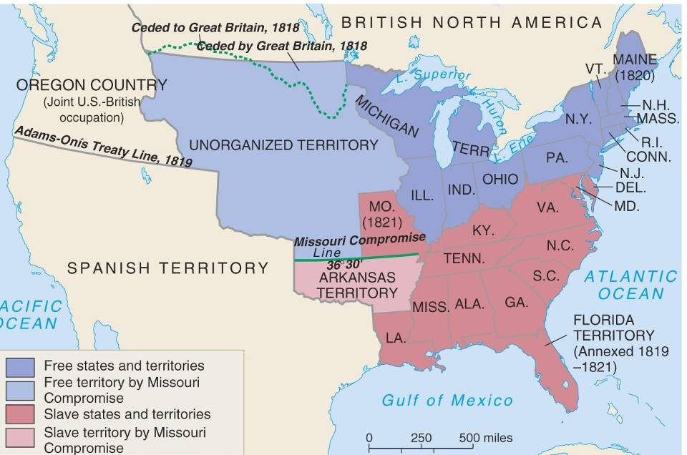
In 1820, Henry Clay negotiated the
Missouri Compromise (Compromise of 1820)
Maine broke from Massachusetts and became a free state
Missouri became a slave state
Slavery was outlawed in
all western territories above the latitude of 36°30'

Slide 37
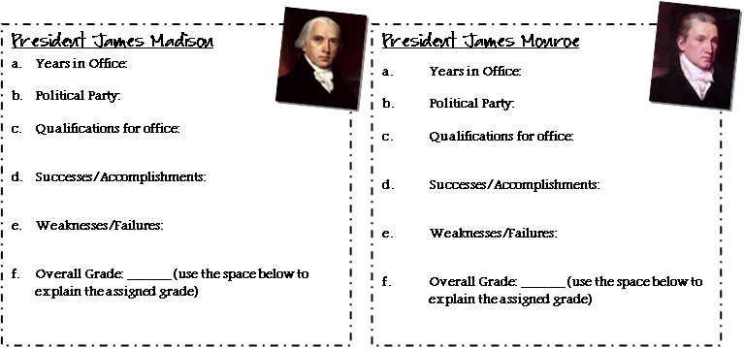
Closure Activity:
Presidential Report Card
Use the information discussed in class to assign a grade to Presidents Madison and Monroe.
While this is your opinion, you MUST support your opinion with specific details!

