Slide 1
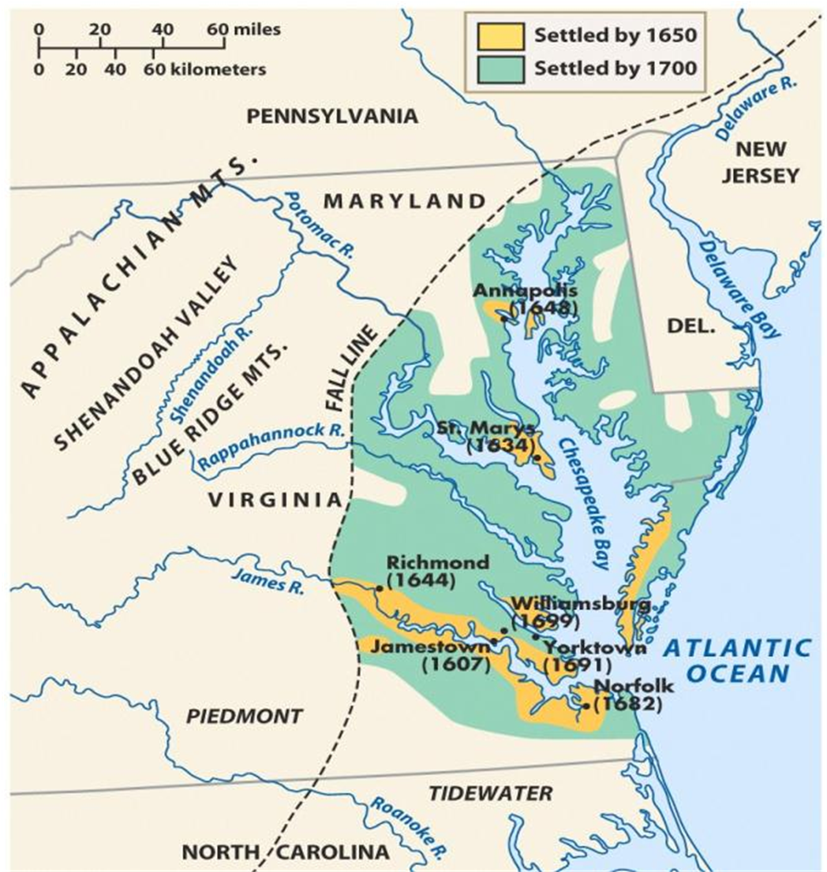
BellRinger 8/11: Looking at this map, why are the earliest colonies often referred to as the “Chesapeake” Colonies?

Slide 2
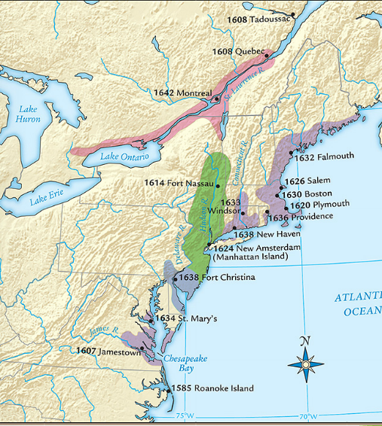
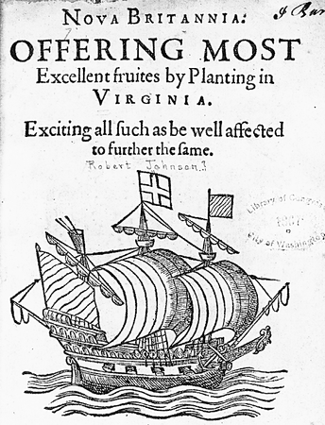
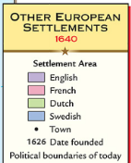
In 1607, settlers founded Jamestown the first permanent British colony in America along the Chesapeake Bay in present-day Virginia
Quick discussion: How did the settlers gain rights and money to create a colony?
In 1606, Virginia Company investors gained a charter from the king, recruited settlers, and sent them to America in search of gold
Jamestown was founded by British entrepreneurs of a joint-stock company called the Virginia Company

Slide 3
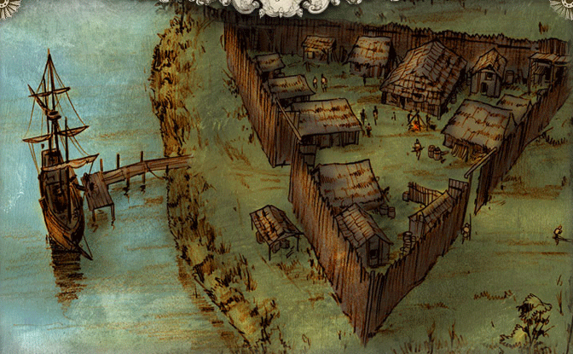
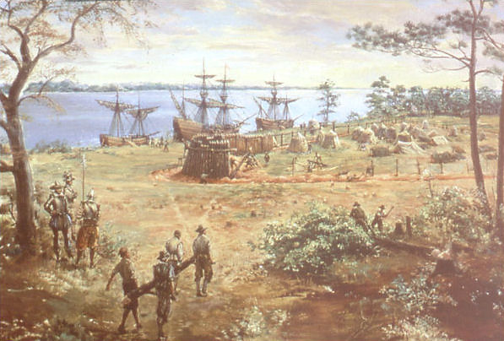
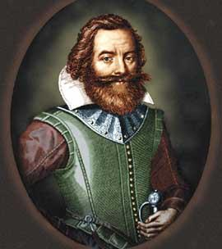
Settlers built a fort, but struggled to survive in their first years in America
Settlers arrived looking for gold so they did not prepare to stay long in America; They did not plant crops & faced starvation
John Smith took control & forced settlers to farm
“He who will not work, will not eat”
Notes:
Clash of cultures; settlers had no experience in founding a settlement-they simply did what they knew. This did not work

Slide 4
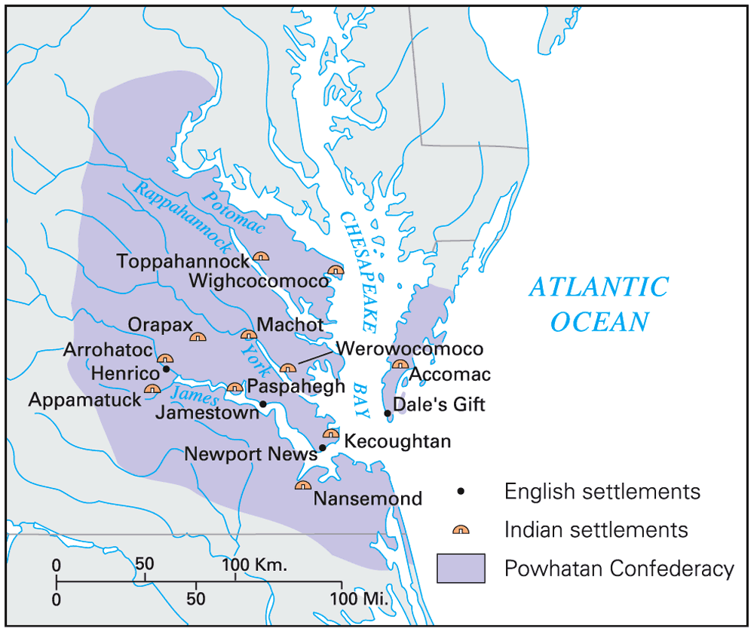
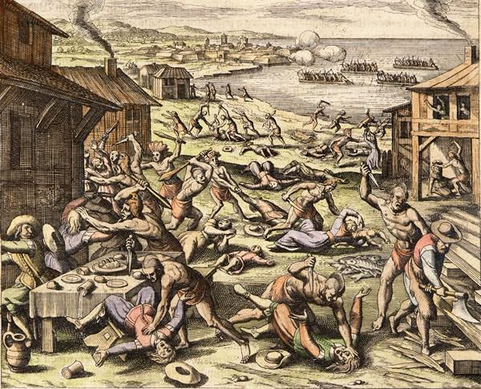
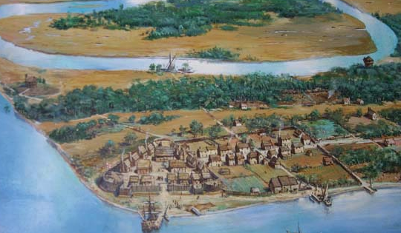
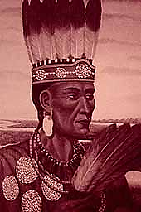
Jamestown was located on a swamp & led to outbreaks of disease among colonists
Jamestown was located in territory controlled by the Powhatan Indians who attacked the settlement
Notes:
The 1622 Powhatan uprising killed 347 Jamestown colonists

Slide 5
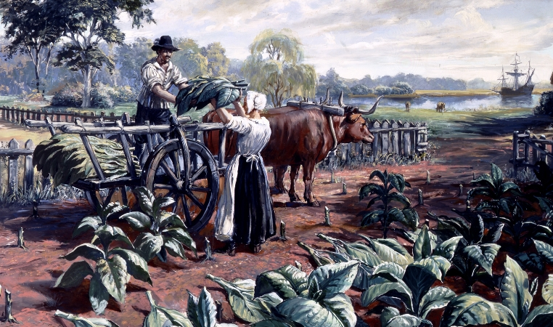
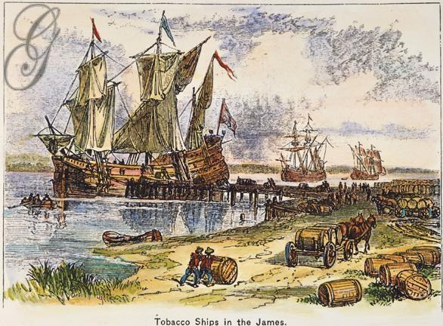
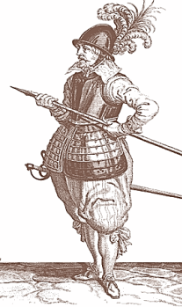
After the Jamestown colonists failed to find gold, the joint-stock investors demanded that colonists find a way to make money
In 1612, John Rolfe introduced tobacco in Jamestown which was popular in Europe & made investors money
Notes:
explain Virginia's development including the Virginia Company, tobacco cultivation, relationships with Native Americans such as Powhatan, development of the House of Burgesses, Bacon's Rebellion, and the origins of American slavery

Slide 6
BellRinger 8/12: How do you predict Jamestown settlers found enough workers to plant, harvest, and package large amounts of tobacco?

Slide 7
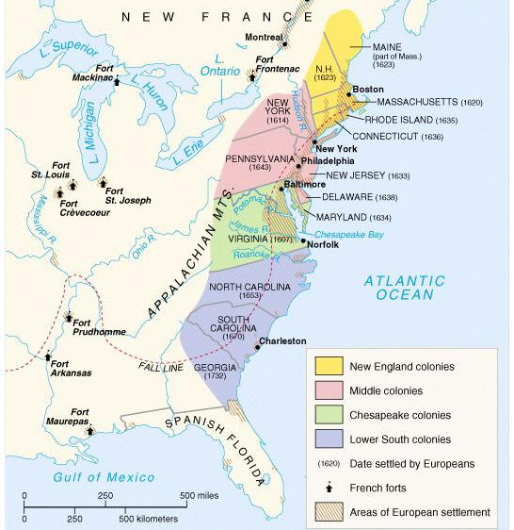
America: Story of Us Jamestown (7.40)
Notes:
Explain Virginia’s development; include the Virginia Company, tobacco cultivation, relationships with Native Americans such as Powhatan, development of the House of Burgesses, Bacon’s Rebellion, and the development of slavery.

Slide 8
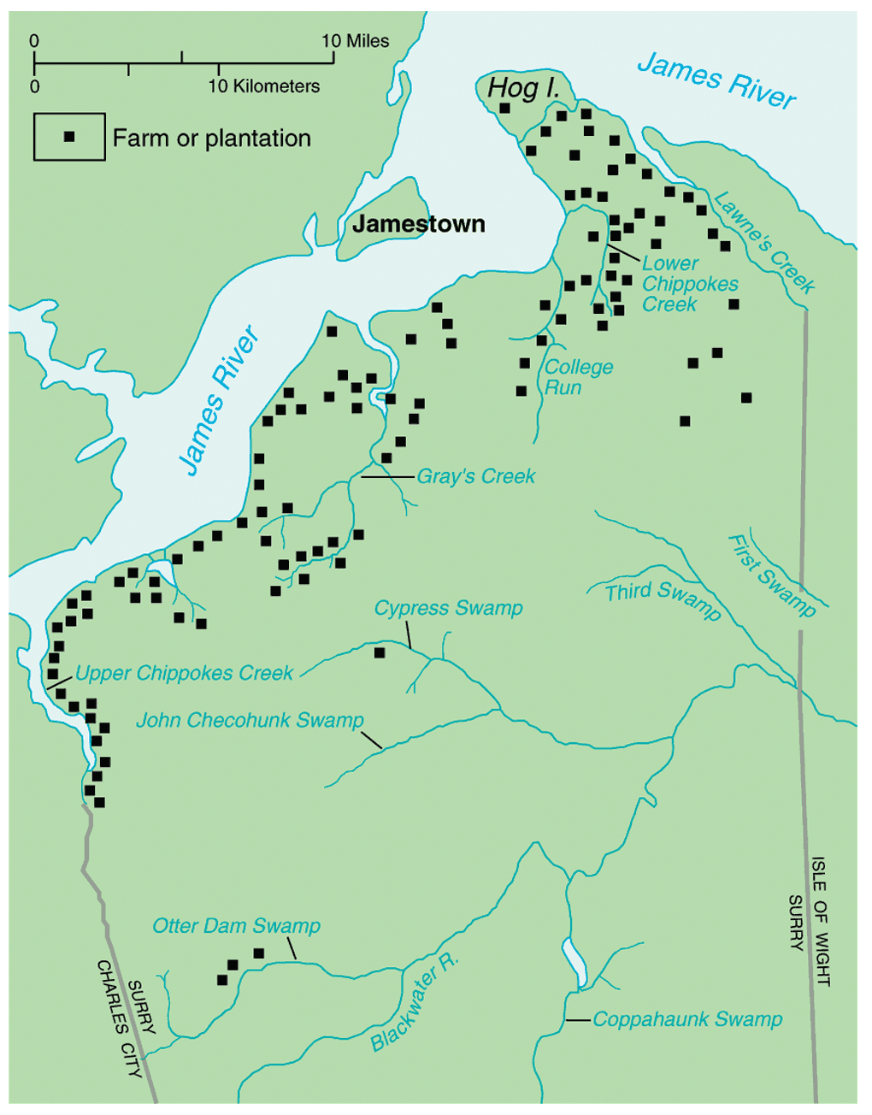
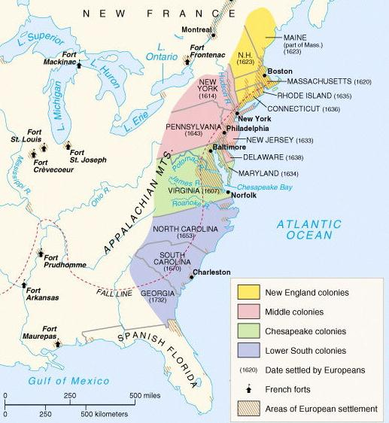
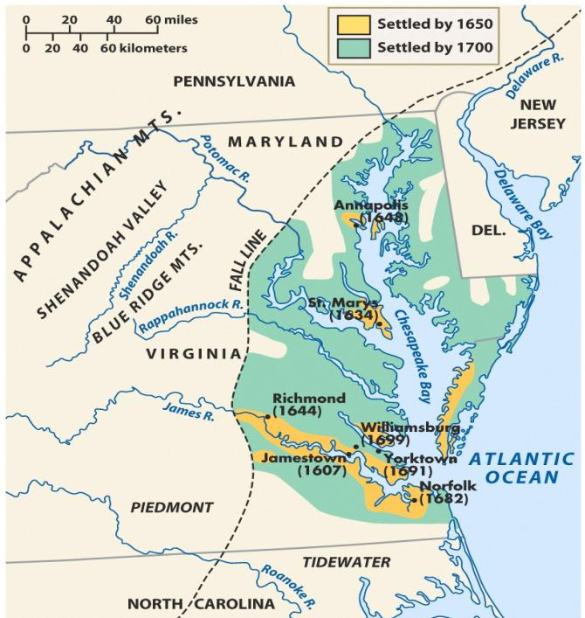
Tobacco was so profitable that colonists planted more, built large plantations, & expanded into new farm lands
Due to the success of tobacco, the Jamestown settlement expanded into the Virginia colony

Slide 9
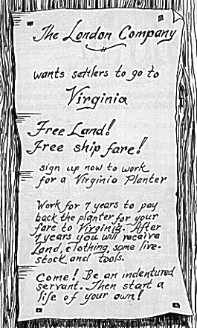
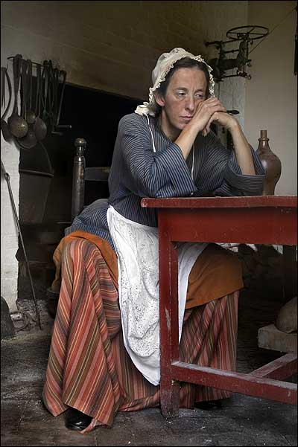
Tobacco created a need for field laborers to plant & pick the tobacco
To meet the demand for workers, landowners in Virginia used indentured servants from England
Indentured servants were typically poor men or women who agreed to work for a land owner for 4 to 7 years in exchange for their travel to America

Slide 10
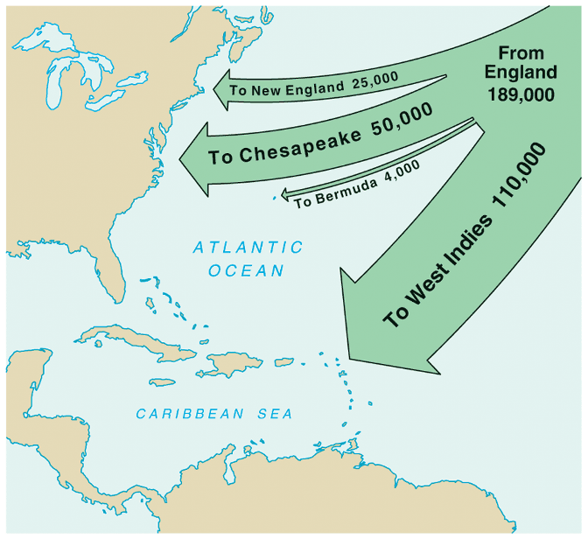
In 1618, Virginia introduced the Headright System which gave 50 acres to anyone who brought an indentured servant to America
The large population of poor people in Britain led thousands of people to immigrating as indentured servants by 1700
Indentured servants were worked hard, treated badly, & many died before their contracts ended
Notes:
Virginia’s growth was due largely to the headright system & indentured servitude
The status of indentured servants in early Virginia and Maryland was not wholly dissimilar from slavery. Servants could be bought, sold, or leased. They could also be physically beaten for disobedience or running away. Unlike slaves, however, they were freed after their term of service expired, their children did not inherit their status, and they received a small cash payment of "freedom dues."

Slide 11
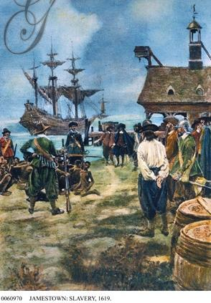
In addition to indentured servants, Virginia landowners also used African slaves who were first brought to Jamestown in 1619
In the mid-1600s, fewer indentured servants came to America as the British economy improved; As a result, African slavery replaced indentured servitude as the dominant labor system in Virginia

Slide 12
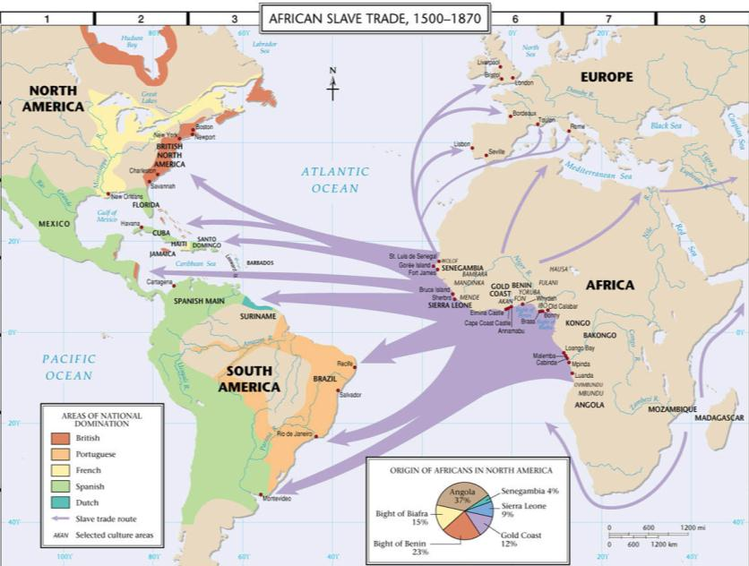
African slaves were transported from Africa to America on slave ships across the “Middle Passage”

Slide 13
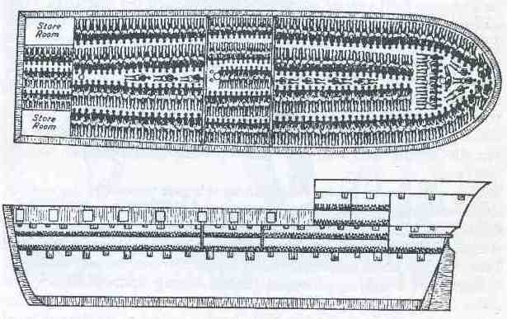
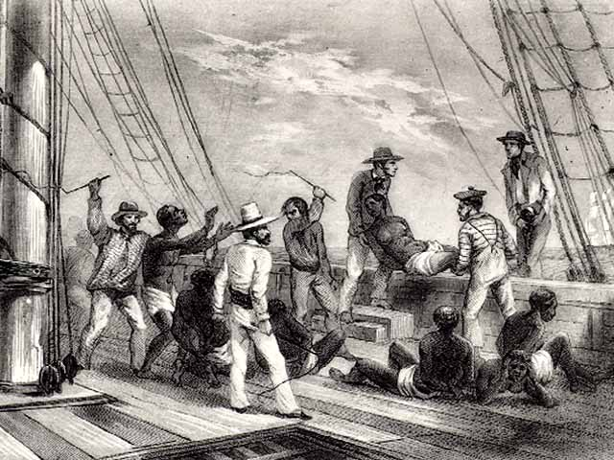
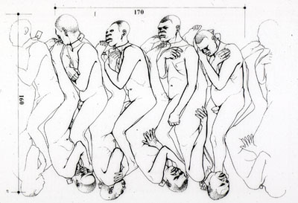
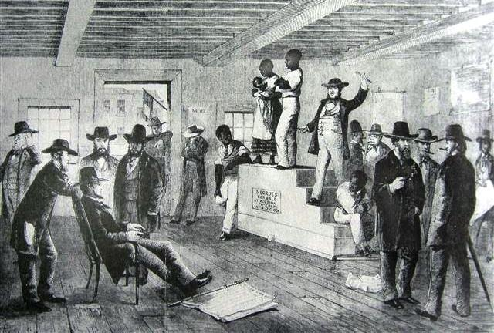
The “Coffin” Position Used Below Desk
African Captives Being Thrown Overboard
Slave auction upon arrival in America

Slide 14
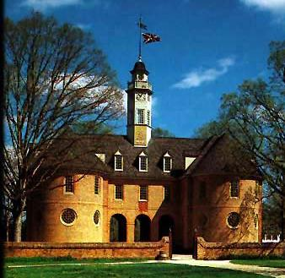
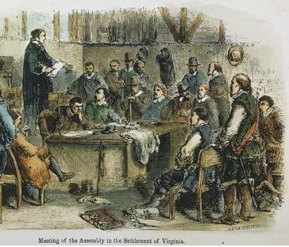
Virginia colonists needed laws to maintain order but the British government was thousands of miles across the Atlantic Ocean
In 1619, Virginians formed the House of Burgesses which was the first legislative assembly in America
Virginia was a royal colony so it had a governor chosen by the king, but the House of Burgesses made the important decisions regarding taxes & laws

Slide 15
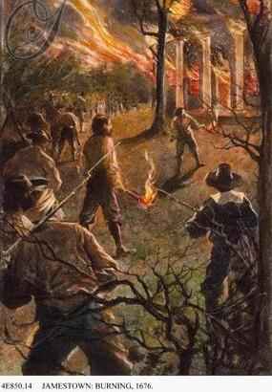
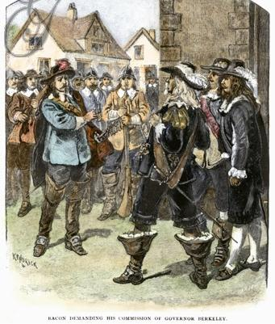
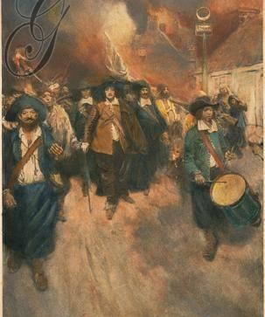
The leaders of the House of Burgesses were elected, but they were rich planters who did not always represent the poor farmers of the colony
Former indentured servants in western Virginia suffered from low tobacco prices & frequent Indian attacks
Poor farmers, led by Nathaniel Bacon, blamed Virginia’s governor for not protecting them & started a rebellion
Bacon’s Rebellion proved to rich Virginians that slaves were better than indentured servants because slaves would never ask for land

